Slide 1
Model-Based Design for DO-178B/C
Presenter: Sang-Ho Yoon
Senior Application Engineer

Slide 2
Agenda
System Certification and Compliance Demonstration
ARP 4754 and DO-178C/DO-331
Model Based V&V Workflow for DO-178B/C
Customer Stories
Conclusion & Questions

Slide 3
Certification, Standards, and Compliance Demonstration

Slide 4

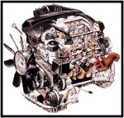


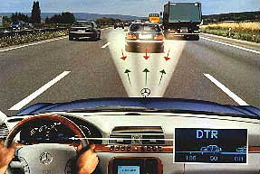



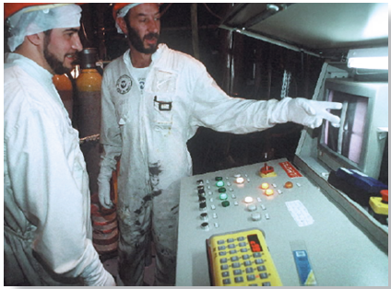
High-Integrity Applications
Software-based systems that are designed and maintained so that they have a high probability of carrying out their intended function
Definition: cf. Buncefield Investigation Glossary http://www.buncefieldinvestigation.gov.uk/glossary.htm
Notes:
High integrity systems은 그 정의에 따르면, 의도된 기능을 수행하는데 있어서 높은 신뢰도를 갖도록 설계되고 유지 보수되는 소프트웨어 기반 시스템을 의미합니다. 결국, 여기서 보시는 바와 같이 자동차, 항공기, 의료기기, 핵/원자력, 철도시스템 등의 안정성 확보가 매우 중요한 애플리케이션을 high integrity application이라고 할 수 있습니다.

Slide 5
Development Processes for High-Integrity Applications
High integrity applications development follows standards and guidelines
Standards and Guidelines have objectives for development process activities
Impose additional constraints on development
Require creation of additional artifacts
Require more thorough verification, validation and testing activities
Standards and Guidelines require evidence that the objectives were met to certify:
compliance demonstration

Slide 6

Development Process for High-Integrity Applications: System Certification
Recognition by a certification authority that an system complies with the requirements of a standard
System certification
Partitioning
Integration
SW safety req. spec
Validation testing
SW architecture
Integration testing (components, subsystems)
SW system design
Integration testing (modules)
Module design
Module testing
Coding

Slide 7
Development Process for High-Integrity Applications: Compliance Demonstration
System certification involves a compliance demonstration:
applicant must provide evidence that the objectives of the standard were met
Compliance demonstration
System certification
Partitioning
Integration
SW safety req. spec
Validation testing
SW architecture
Integration testing (components, subsystems)
SW system design
Integration testing (modules)
Module design
Module testing
Compliance
demonstration
Coding
Compliance demonstration is a lengthy and labour-intensive process

Slide 8
ARP 4754 and DO-178C/DO-331

Slide 9






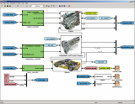



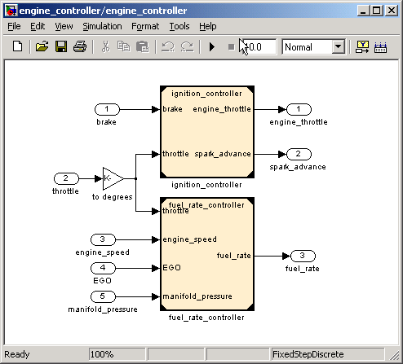
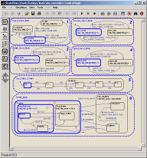
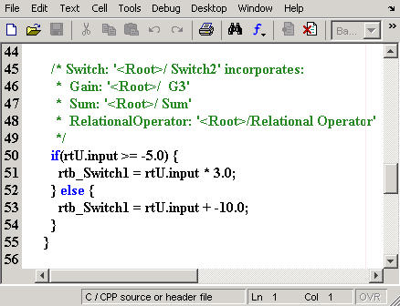
Embedded System Development
With MATLAB, Simulink, Stateflow, Simscape, Embedded Coder & HDL Coder
+
Environment
Model
-
Systems
ARP-4754
Hardware
ARP-4754
DO-254
SW & HW
Models
Software
DO-178
Notes:
The MathWorks
9

Slide 10
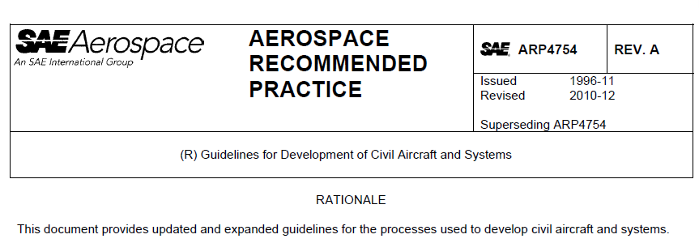
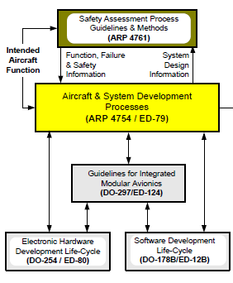
Systems Development : ARP 4754A – Dec. 2010
What’s new (since 1996)
Clarifies applicability to any system using hardware and software items
Introduces fDAL and iDAL
More modeling guidance
Notes:
functional development assurance level (FDAL), item development assurance level (IDAL)

Slide 11
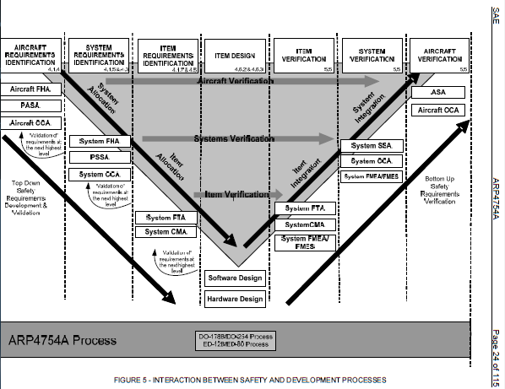
ARP 4754A: System Engineering for Everyone
Systems
ARP 4754
Software
DO-178
Hardware
DO-254

Slide 12
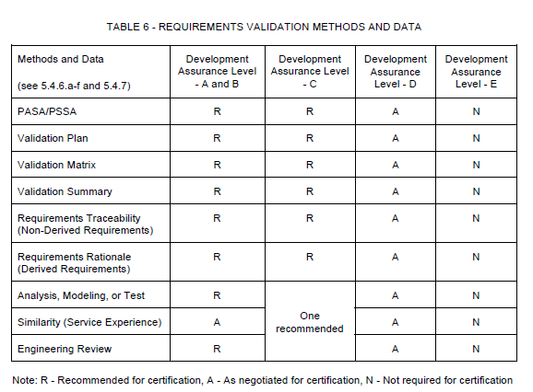
ARP4754A Recommends use of System Models

Slide 13
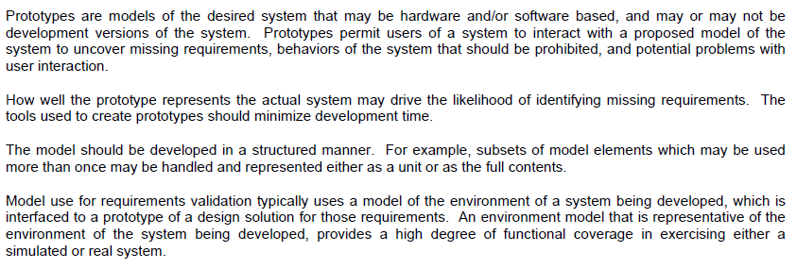
ARP4754A Recommends use of good system models that represent the actual system and its environment

Slide 14
Embedded System Development
With MATLAB, Simulink, Stateflow, Simscape, Embedded Coder & HDL Coder
+
Plant
Environment
-
Systems
ARP-4754
Hardware
DO-254
Controller
Application
Software
DO-178
Notes:
The MathWorks
14

Slide 15
RTCA/DO-178 Software Considerations in Airborne Systems and Equipment Certification
Purpose - Provides guidelines for the production of airborne software that performs its intended function and avoids unintended function
Guidance includes
Software life cycle objectives
Development and verification activity descriptions
Descriptions of evidence needed to indicate the objectives were satisfied
http://www.rtca.org/

Slide 16
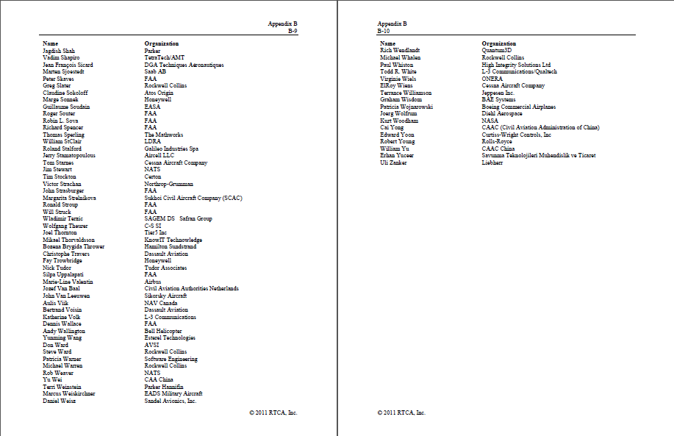
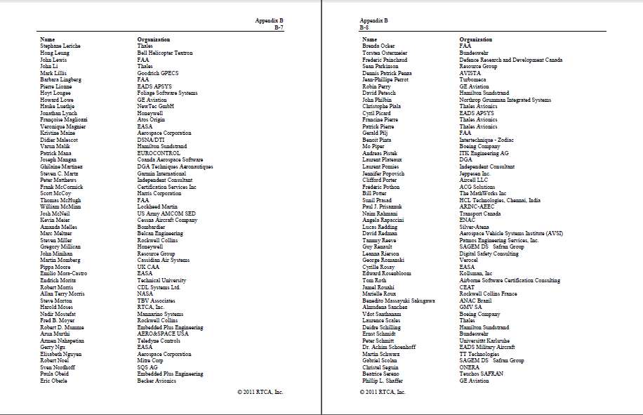
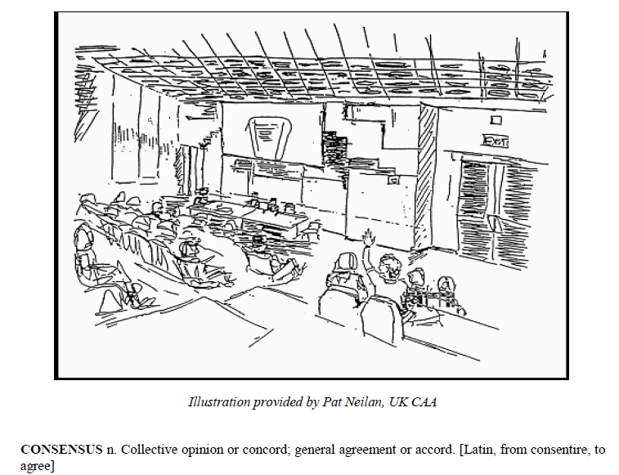
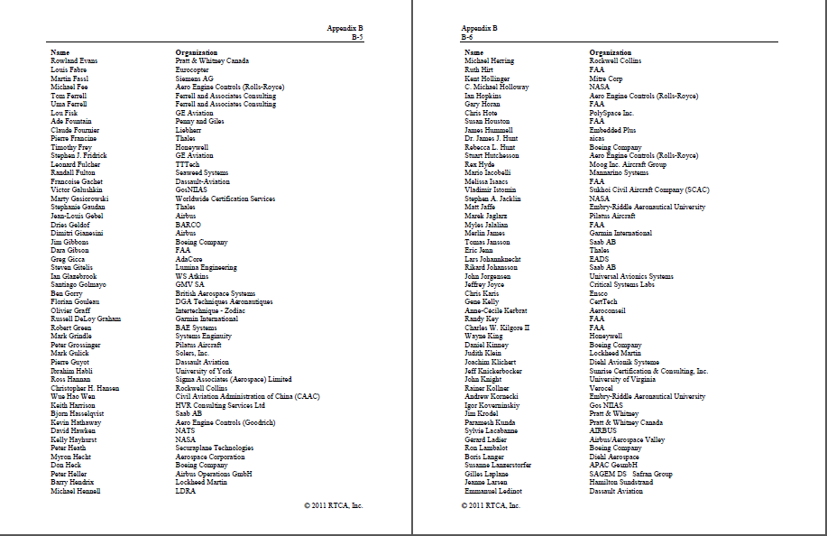
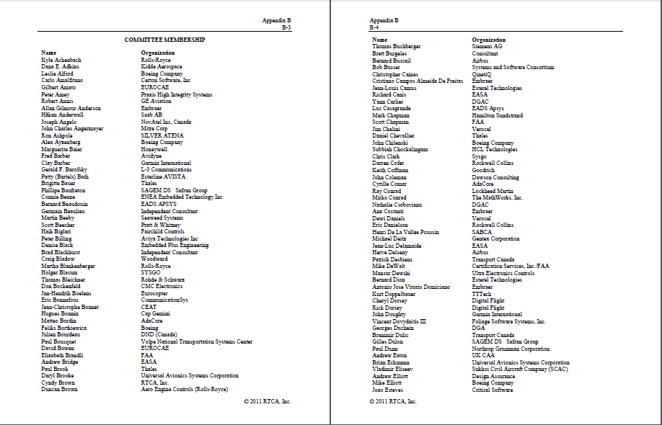
DO-178 Creation and Update Approach
Consensus driven
Large Committee
Excerpt from DO-178B and DO-178C
Committee membership excerpt from DO-178C (includes MathWorks)

Slide 17
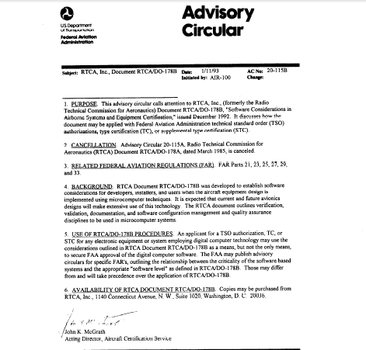
DO-178 History
Version | RTCA Publication* | FAA Acceptance**
DO-178 | 1982 | 1982
DO-178A | 1985 | 1986
DO-178B | 1992 | 1993
DO-178C | Dec. 2011 | 2013
AC 20-115B
http://rgl.faa.gov/
*Published in Europe by EUROCAE as ED-12
**Accepted by EASA in Europe as AMC 20-115B

Slide 18
The new landscape for RTCA documents from DO-178B to DO-178C
DO-178C Software Considerations in Airborne Systems and Equipment Certification (Revised)
DO-278A Software Integrity Assurance Considerations for Communication, Navigation, Surveillance and Air Traffic Management (CNS/ATN) Systems (Revised)
DO-248C Supporting Information for DO-178C and DO-278A (Revised)
DO-330 Software Tool Qualification Considerations (New!)

Slide 19
The new landscape for RTCA documents from DO-178B to DO-178C
DO-331 Model-Based Development and Verification Supplement to DO-178C and DO-278A (New!)
DO-332 Object-Oriented Technology and Related Techniques Supplement to DO-178C and DO-278A (New!)
DO-333 Formal Methods Supplement to DO-178C and DO-278A (New!)

Slide 20

DO-178C Supplements
DO-178C supplements:
DO-330 for Tool Qualification
DO-331 for Model-Based Design
DO-332 for Object Oriented Techniques
DO-333 for Formal Methods
All supplements impact MathWorks products

Slide 21
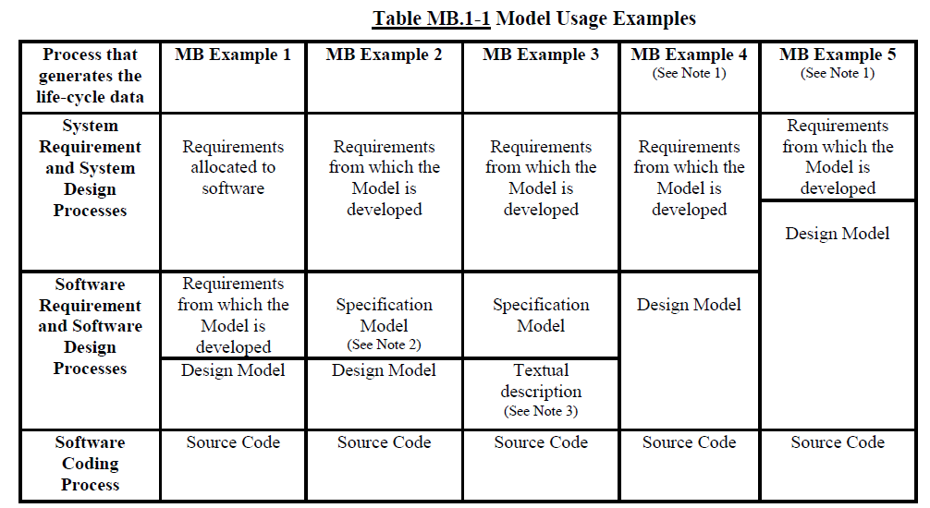
DO-331: System/Software Mapping Guidance

Slide 22
DO-178C Supplements
DO-178C supplements:
DO-330 for Tool Qualification
DO-331 for Model-Based Design
DO-332 for Object Oriented Techniques
DO-333 for Formal Methods
All supplements impact MathWorks products

Slide 23
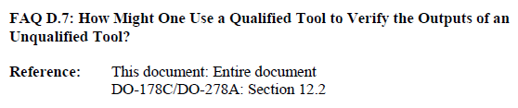
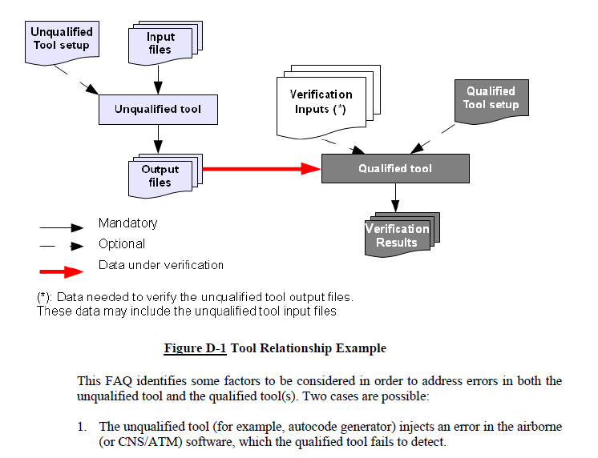
DO-330 - Qualification Tool Relationship
MathWorks approach is to automate code verification (instead of skipping verification)
and qualify verification tools (TQL 4 & 5)

Slide 24
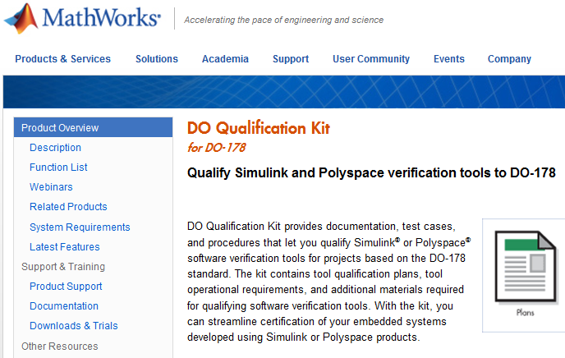
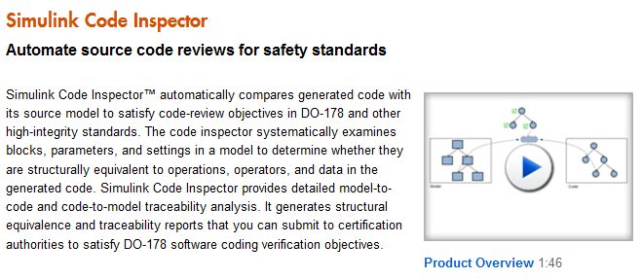
DO Qualification Kit (for DO-178C)
MathWorks Verification tools supported by DO Qualification Kit
Simulink V&V
DO-178 model checks
Model coverage tool
Simulink Report Generator
System Design Description report
Simulink Code Inspector
Trace and conformance reports
Polyspace
Run-Time Error detection
MISRA Checking

Slide 25
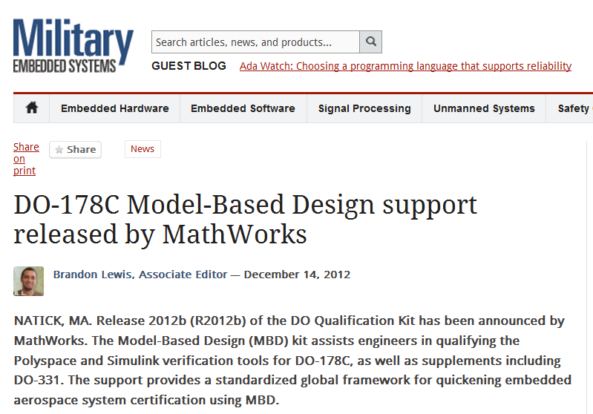
MathWorks First to Support DO-178C with Model-Based Design
Starting with Release 2012b, engineers using the DO Qualification Kit can qualify Simulink and Polyspace verification tools for DO-178C and supplements including DO-331.
This DO-178C support now offers program managers and their certification authorities a standardized, global approach and framework for adopting Model-Based Design and accelerating embedded system certification.
In R2012b, DO Qualification Kit also supports Simulink and Polyspace products for the following supplements to DO-178C:
DO-330 Software Tool Qualification Considerations
DO-331 Model-Based Development & Verification
DO-332 Object-Oriented Technology & Related Techniques
DO-333 Formal Methods
“The verification workflow described in the DO Qualification Kit matches industry best practice and the expectations of the FAA software certification community, including verification independence, executable object code verification, and structural coverage analysis for automatically generated code.”
Steve Morton
Level A FAA Software DER
http://www.mathworks.com/company/newsroom/MathWorks-Offers-Support-for-DO-178C-with-Model-Based-Design.html

Slide 26
Introduction to Model-Based Design

Slide 27
Development Process
Verification and Validation
Requirements
Ind. Standards
User Acceptance Testing
Requirements
Complete
Integration
& Test
Integration testing
Environment
System-Level
Specification
Physical
Components
System-Level
Integration & Test
Algorithms
Code Verification and Validation
Subsystem
Design
Generate
Subsystem
Integration & Test
C, C++
HDL
MCU
DSP
FPGA
ASIC
Subsystem
Implementation
Notes:
So to explain model based design we first need to look at the problems typically associated with a traditional development process.
We will use a design V, common in Automotive and familiar in some Aerospace companies and other industries.
The “V” is a 2D view of a development process – the x-axiz is time, while the y-axiz is abstraction. As you move down the left hand side of the V you add more and more details to the design with implementation at the vertex. As you move up the right hand side of the V, you do higher and higher levels of integration and test with final working products at the end.
[Build, step through animation]
We can generalize this process into the phases of specification, designing, implementing, and testing,
Additional notes
Projects start with a definition of the requirements of the product to be created.
This set of requirements leads to a specification of the system. Then each subsystem is designed and implemented. How this is done depends a lot on the product involved and its complexity. We won’t try to capture all possible ways that this can be accomplished. But as you move further down, you add additional detail. With implementation at the Apex.
With all subsystems designed and implemented, integration and test begins, at higher and higher levels, leading ultimately to a final, working product.

Slide 28
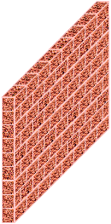

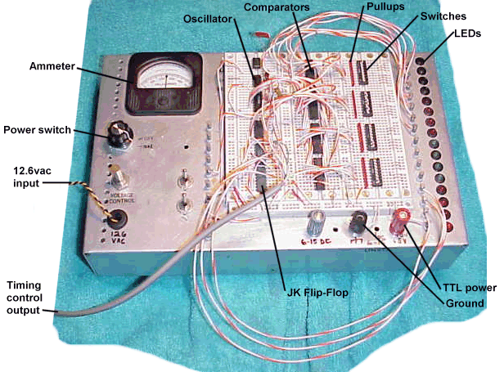


Problems with Traditional Development
Requirements and
Specifications
Design
Implementation
Test and Verification

Slide 29
Price of Late Verification and Validation Relative Cost to Fix Defects
High cost of fixing defects detected late
Difficult to know when “enough” testing is done
As design complexity increases, time and cost to test does too
Relative Cost to Fix Defects per Phase Found
50
45
40
35
30
Relative Cost
25
to Fix
Defect
20
Type
15
Requirements
10
Design
5
Code
Test
0
Design
Code
Test
Requirements
Phase Found
Test
Code
Design
Requirements
Source: Return on Investment for Independent Verification & Validation, NASA, 2004.

Slide 30
Adopting Model-Based Design
Requirements and
Specifications
Design
Environment Models
System Behavior Models
Environment Models
Implementation
Physical
Components Models
Executable models
Unambiguous, “one truth”
Links to textual requirements
Algorithms
Algorithms
Test and Verification
Simulation
Reduces need for physical prototypes
Enables systematic “what-if” analysis
Generate
Generate
C, C++
VHDL, Verilog
MCU
DSP
FPGA
ASIC
Automatic code generation
Reduces time, effort
Enables code reuse
Minimizes coding errors

Slide 31
Redesigned Workflow
Requirements and
Specifications
Design
Model Elaboration
Environment Models
System Behavior Models
Environment Models
Implementation
Physical
Components Models
Executable models
Unambiguous, “one truth”
Links to textual requirements
Algorithms
Continuous Verification
Algorithms
Test and Verification
Simulation
Reduces need for physical prototypes
Enables systematic “what-if” analysis
Generate
Generate
C, C++
VHDL, Verilog
MCU
DSP
FPGA
ASIC
Automatic code generation
Reduces time, effort
Enables code reuse
Minimizes coding errors

Slide 32
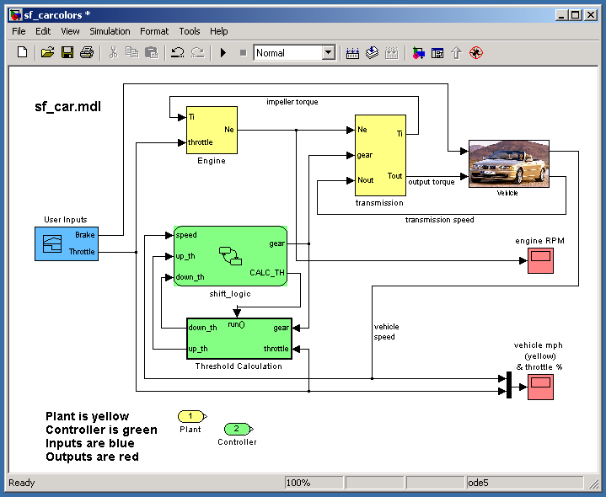
Redesigned Workflow
Requirements and Specifications
Design
Design
Environment Models
Environment
System Behavior Models
Environment Models
Implementation
Physical Components
Physical
Components Models
Executable models
Unambiguous, “one truth”
Links to textual requirements
Algorithms
Algorithms
Algorithms
Test and Verification
Simulation
Reduces need for physical prototypes
Enables systematic “what-if” analysis
Generate
Generate
Generate
Generate
Embedded Software
Digital Electronics
C, C++
VHDL, Verilog
C, C++
VHDL, Verilog
MCU
DSP
FPGA
ASIC
MCU
DSP
FPGA
ASIC
Automatic code generation
Reduces time, effort
Enables code reuse
Minimizes coding errors
Integration
Implement

Slide 33
Redesigned Workflow
Design
Environment
Physical Components
Algorithms
Generate
Generate
Embedded Software
Digital Electronics
C, C++
VHDL, Verilog
MCU
DSP
FPGA
ASIC
Integration
Implement

Slide 34
Redesigned Workflow
Requirements
Design
Environment
Physical Components
Algorithms
Generate
Generate
Embedded Software
Digital Electronics
C, C++
VHDL, Verilog
MCU
DSP
FPGA
ASIC
Test
Environments
Integration
Implement
Continuous V&V

Slide 35
Redesigned Workflow
Requirements
Design
Executable Specifications from Models
Environment
Design with Simulation
Physical Components
Algorithms
Generate
Generate
Continuous Test and Verification
Embedded Software
Digital Electronics
C, C++
VHDL, Verilog
MCU
DSP
FPGA
ASIC
Test
Environments
Implementation with Automatic Code Generation
Integration
Implement
Continuous V&V

Slide 36
Model Based V&V Workflow for DO-178B/C
Notes:
[Timing: 15 minutes for Intro]

Slide 37
Workflow Example
Validate
Requirements
Trace
Verify
Conformance
Verify
Design
Trace
Conformance
Source Code
Verify
Verify
Object Code

Slide 38
Workflow Example
* DO-178C Qualifiable Tool
Verify
EC: PIL
Simulink Report Generator
Polyspace*
Validate
Trace
SLVNV: RMI
SLRG: SDD *
Requirements
Code Coverage
Tool
Trace
Simulink
Stateflow
SLRG: SDD *
Verify
Conformance
SLVNV: DO-178C/DO-331
Checks *
Verify
Simulink Report
Generator
SLVNV: Model Coverage *
Simulink Design Verifier
Conformance
Verify
Trace
Embedded Coder
Simulink Code Inspector*
Model
Trace
Conformance
PS:MISRA-C
Checks *
Verify
EC: PIL
Simulink Report Generator
Polyspace*
Embedded Coder
Abbreviations
SL: Simulink
SLVNV: Simulink Verification and Validation
RMI: Requirements Management Interface
SDD: System Design Description
SLDV: Simulink Design Verifier
SLRG: Simulink Report Generator
PS: Polyspace
RTE: Run-Time Error
EC: Embedded Coder
PIL: Processor-in-the-Loop
Conformance
Source Code
Verify
Simulink Code
Inspector*
Verify
Code Coverage
Tool
Verify
Compiler/IDE
Object Code

Slide 39
Case Study: Autopilot System
Notes:
[Timing: 15 minutes for Intro]

Slide 40
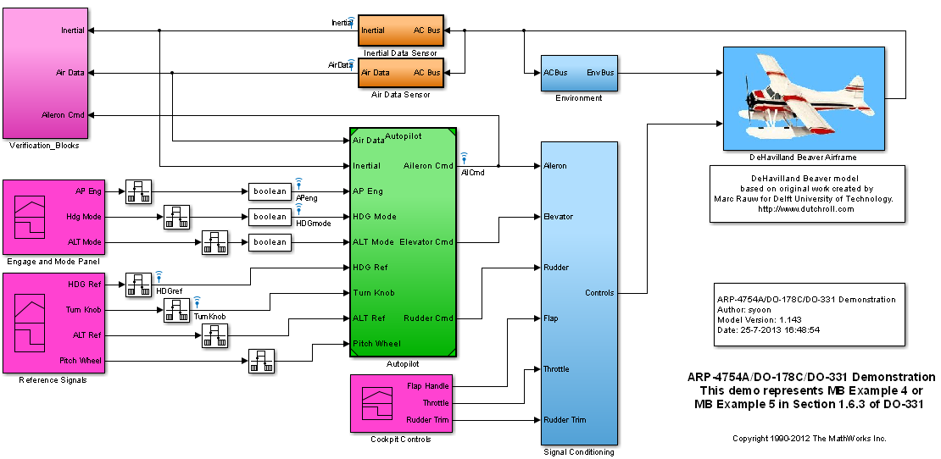
Defining the System

Slide 41
1) Design with Requirement

Slide 42
Workflow Example
* DO-178C Qualifiable Tool
Validate
Requirements
Trace
Simulink
Stateflow
SLRG: SDD *
Verify
Conformance
Verify
Model
Trace
Abbreviations
SL: Simulink
SLVNV: Simulink Verification and Validation
RMI: Requirements Management Interface
SDD: System Design Description
SLDV: Simulink Design Verifier
SLRG: Simulink Report Generator
PS: Polyspace
RTE: Run-Time Error
EC: Embedded Coder
PIL: Processor-in-the-Loop
Conformance
Source Code
Verify
Verify
Object Code

Slide 43
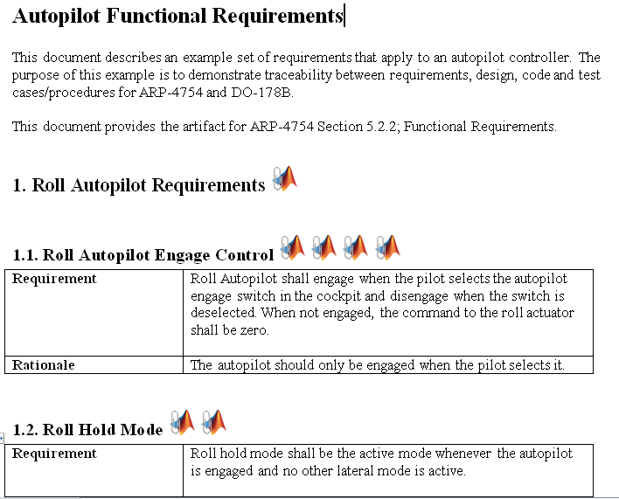
Requirement Specification
Notes:
Overview of SBR requirements
Nothing much has changed for functional requirements from the original.
Now the testing requirements have pictures of test cases. The test cases are also available in xls format(sbrTestCase.xls) and this will later be used to create Signal Builder.

Slide 44
Modeling with Simulink
Requirements
Requirements
Create executable specifications
Design with simulation
Advantages:
Eliminate ambiguity
Facilitate team communication and component-based modeling
Analyze and improve requirements and design through simulation
Test system performance before building physical prototypes
Automate document generation
Design
Environment
Physical Components
Algorithms
Hand- Generate
Generate
Generate
Digital Electronics
Embedded Software
VHDL, Verilog
C, C++
FPGA
ASIC
MCU
DSP
Integration
Implement

Slide 45
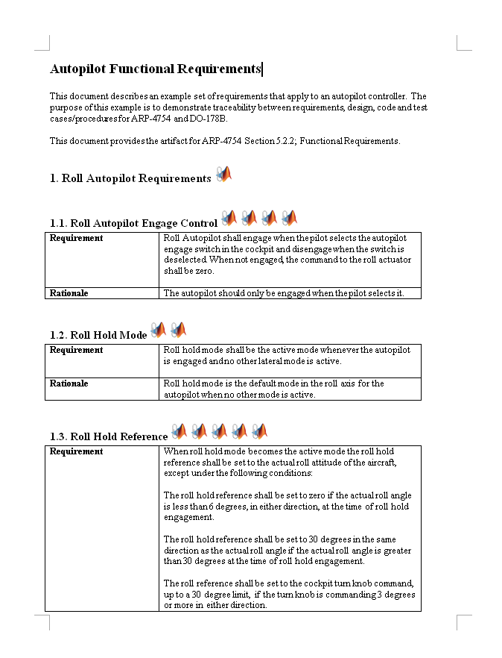
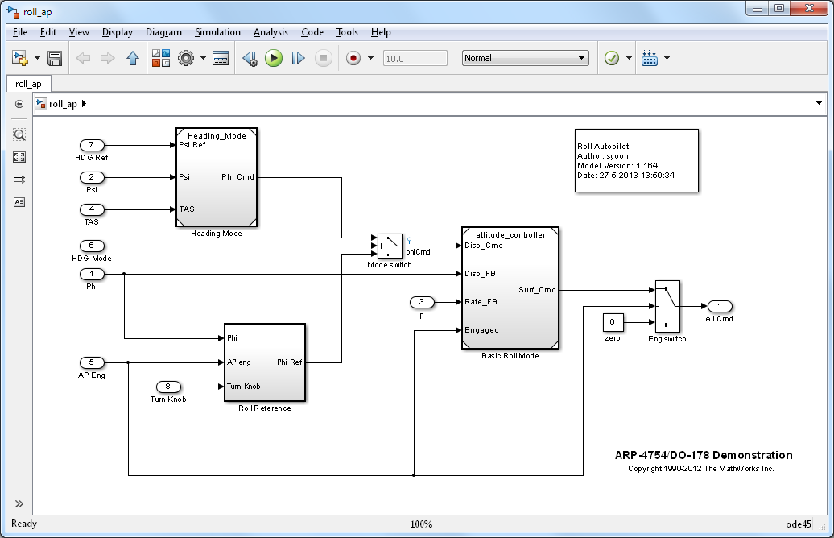
Roll Autopilot Algorithm Model
Requirements
Roll Autopilot Model
Notes:
So we have created SBR algorithm model from the requirement!
>> sbr ( show the complete SBR algorithm model)
Do simple testing with constant blocks as inputs and display as output or
>>sbr_testHarness_simple

Slide 46
Workflow Example
* DO-178C Qualifiable Tool
Validate
Trace
SLVNV: RMI
SLRG: SDD *
Requirements
Trace
Simulink
Stateflow
SLRG: SDD *
Verify
Conformance
Verify
Model
Trace
Abbreviations
SL: Simulink
SLVNV: Simulink Verification and Validation
RMI: Requirements Management Interface
SDD: System Design Description
SLDV: Simulink Design Verifier
SLRG: Simulink Report Generator
PS: Polyspace
RTE: Run-Time Error
EC: Embedded Coder
PIL: Processor-in-the-Loop
Conformance
Source Code
Verify
Verify
Object Code

Slide 47
Traceability
Functional Requirements
Design
Environment
Physical Components
Tracing Requirements⬄Model Simulink® Verification and Validation™
Tracing Model⬄Source Code Embedded Coder™
Tracing Requirements⬄Source Code Simulink Verification and Validation
Algorithms
Hand- Generate
Generate
Generate
Digital Electronics
Embedded Software
VHDL, Verilog
C, C++
FPGA
ASIC
MCU
DSP
Integration
Implement
Notes:
The left side of the diagram represents the design process that goes from high level requirements, and design, elaboration and implementation. All the way to deployment on the target. (click)
Traditionally, the majority of the verification and validation effort happens at the SW and SW/HW integration phase. (click)
What we are going to focus on today are methods for early verification and validation that allow you to shift a portion of your V&V effort earlier in the development and allow you to find and fix problems earlier. These early V&V methods are enabled through the use of MBD and I hope that after this sess

Slide 48
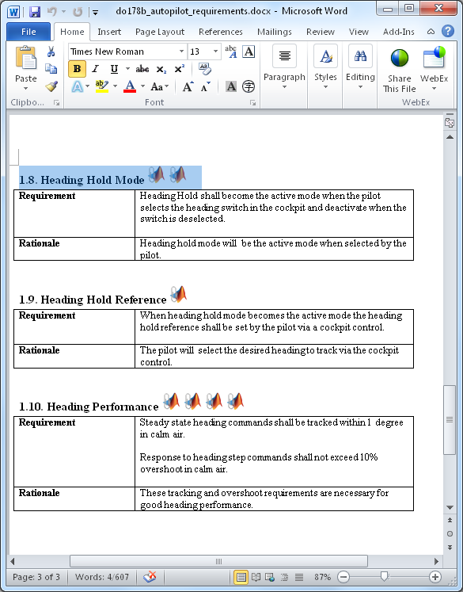
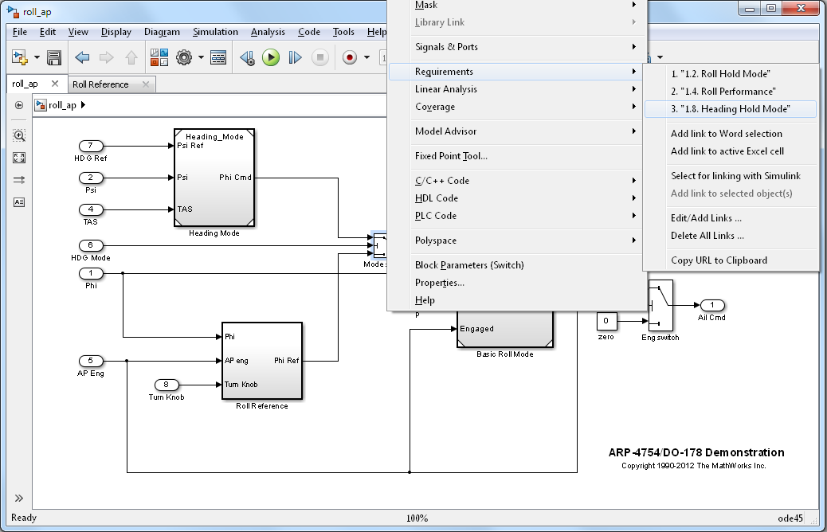
Tracing Requirements⬄Model Simulink Verification and Validation
Creating links between textual documents and model objects
Notes:
Suggestion for the presenter: Highlight the key features mentioned on the slide and then talk about the benefits of requirements linking – why is this important for the customer.
Typically requirements are scattered around in different documents, whether it is a managed environment, or not. Simulink and Stateflow models are used in conjunction with these predominantly textual documents to describe the details of the design. This situation raises many challenges – models and textual documents can get out of sync, it is difficult to navigate to the right requirement, especially if there are multiple versions of it – whether it is to review the latest revision, or to write a requirement.
To address these problems Simulink Verification and Validation provides an infrastructure that allows you to link a particular document paragraph to any block, state, or transition in the model. Typically this capability is used to assign high level requirements to subsystems, or low level requirements to specific implementation details, or even component tests in Simulink.
The supported format for textual documents are… (list)
The requirements linking capability has several features that can help you review traceability between the model and the text and if RTW-EC is used for code generation, linked textual information can be propagated to the generated code in form of code comments.

Slide 49
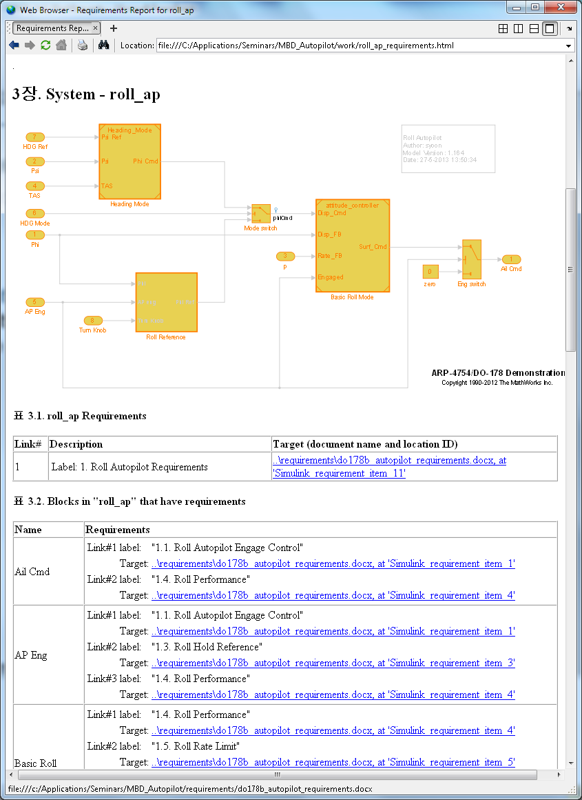
Requirements Traceability – Report Simulink Verification and Validation
Requirements Report provides screenshots of the model and lists all the associated requirements

Slide 50
System Design Description and Web view
Report generation can be used to report on:
Added text description
Graphical modeling elements
Model and block settings
Properties of data being used
Simulink Report Generator generates an SVG representation of the model

Slide 51
Workflow Example
* DO-178C Qualifiable Tool
Validate
Trace
SLVNV: RMI
SLRG: SDD *
Requirements
Simulink
Stateflow
SLRG: SDD *
Verify
Conformance
SLVNV: DO-178C/DO-331
Checks *
Conformance
Verify
Model
Trace
Abbreviations
SL: Simulink
SLVNV: Simulink Verification and Validation
RMI: Requirements Management Interface
SDD: System Design Description
SLDV: Simulink Design Verifier
SLRG: Simulink Report Generator
PS: Polyspace
RTE: Run-Time Error
EC: Embedded Coder
PIL: Processor-in-the-Loop
Conformance
Source Code
Verify
Verify
Object Code

Slide 52
Modeling and Coding Standards
Coding Standards
Modeling Standards
Design
Environment
Physical Components
Modeling Standards Checking Simulink Verification and Validation
Algorithms
Hand- Generate
Generate
Generate
Coding Standards Checking PolySpaceTM Client for C/C++
Digital Electronics
Embedded Software
VHDL, Verilog
C, C++
FPGA
ASIC
MCU
DSP
Integration
Implement

Slide 53
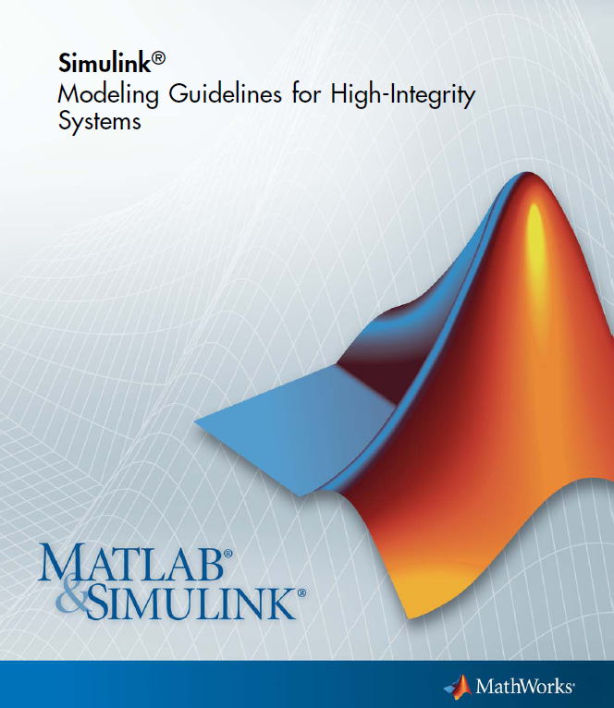
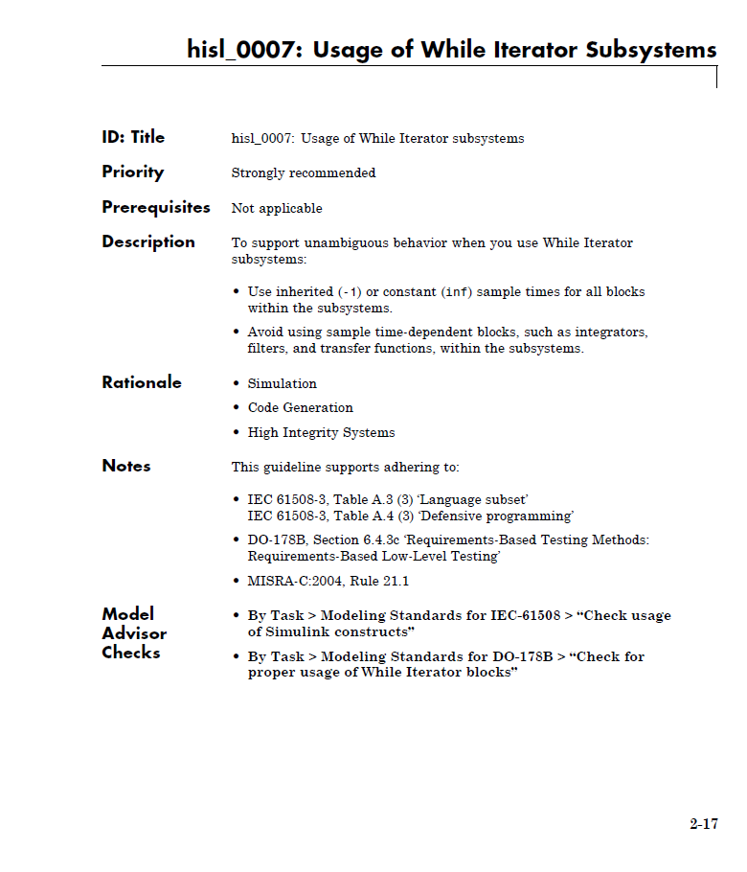
Modeling Guidelines for High-Integrity Systems
Leverage industry-best practices and MathWorks tool expertise when developing high-integrity systems
Modeling Guidelines and corresponding Model Advisor checks to facilitate modeling standards and guidelines objectives of ISO 26262, IEC 61508, DO-178B, and MISRA-C
http://www.mathworks.com/help/pdf_doc/simulink/hi_guidelines.pdf

Slide 54
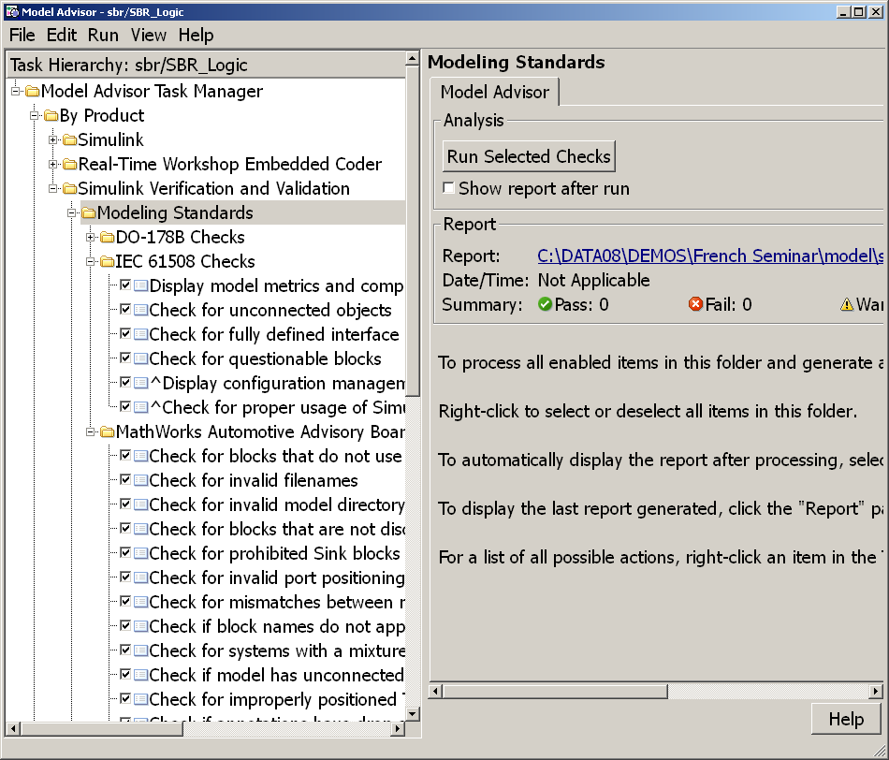
Modeling Standards Checking Overview Simulink Verification and Validation
Static analysis of models against a set of checks
Checks for simulation
Checks for code generation
Requirements Consistency
Modeling Standards
Modeling Standards Checks for:
MAAB Style Guidelines
DO-178B
IEC 61508
ISO 26262
Extensibility API

Slide 55
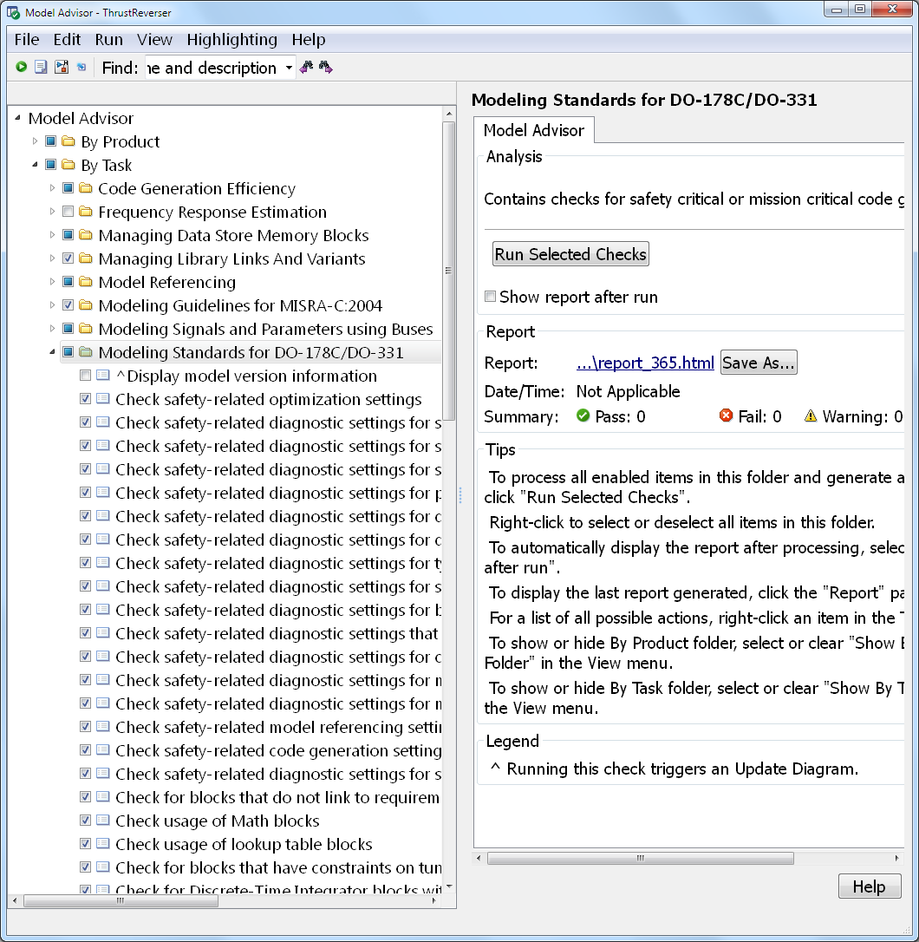
DO-178C Checks
Focus on generation of safety critical code from models
Assist in MISRA-C compliance
Maximize traceability of code to model
Minimize differences between model coverage and code coverage
Maximize the use of built-in Simulink and Stateflow diagnostics during simulation

Slide 56
2) Design Verification

Slide 57
Workflow Example
* DO-178C Qualifiable Tool
Validate
Trace
SLVNV: RMI
SLRG: SDD *
Requirements
Simulink
Stateflow
SLRG: SDD *
Verify
Conformance
SLVNV: DO-178C/DO-331
Checks *
Verify
Simulink Report
Generator
SLVNV: Model Coverage *
Simulink Design Verifier
Verify
Model
Trace
Abbreviations
SL: Simulink
SLVNV: Simulink Verification and Validation
RMI: Requirements Management Interface
SDD: System Design Description
SLDV: Simulink Design Verifier
SLRG: Simulink Report Generator
PS: Polyspace
RTE: Run-Time Error
EC: Embedded Coder
PIL: Processor-in-the-Loop
Conformance
Source Code
Verify
Verify
Object Code

Slide 58
Module and Integration Testing Test Scenario
Open-loop module tests
Coverage measurement
Closed-loop integration tests
Requirements-based testing using the signal builder block
Notes:
In testing, we have focused on testing of modules as the formal activity using requirements based testing and measuring coverage.
The integration tests are closed-loop and focus on integration and non-functional requirements
We will see how the signal builder block can be used to trace requirements to tests

Slide 59
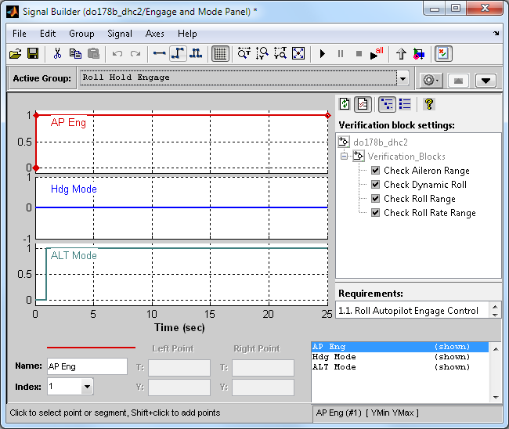
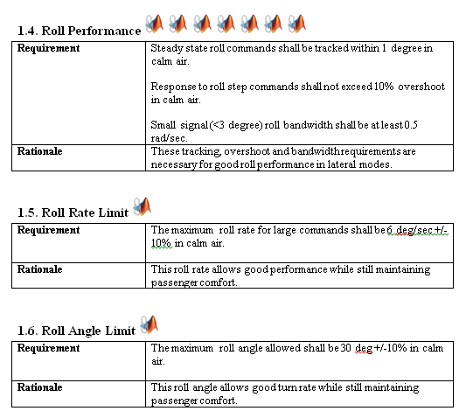
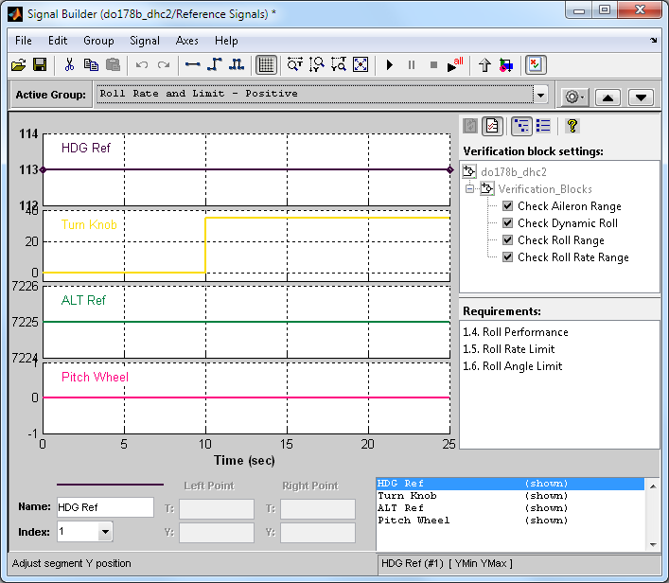
Test Cases to Signal Builder
Test Requirement
Signal Builder
Notes:
Now is the time to revisit Testing Requirements. Revise the test cases in sbr_testing_requirements.doc.
First show how the first test case can be easily created using Signal Builder
Key : Constant at 0
SeatBeltFasten : Square wave at frequency 2
Speed : Triangle wave at default setting
SeatBeltIconExp : Constant at 0
Now, Let’s make use of the sbrTestCase.xls file.
Open xlsSignalGui
Push open button and select sbrTestCase.xls file
Press generate button
A Signal Builder block will be created into a Simulink model
# There is a bug on using commands to create Signal Builder block. After the block gets generated click all the test case tabs to overcome this issue!

Slide 60
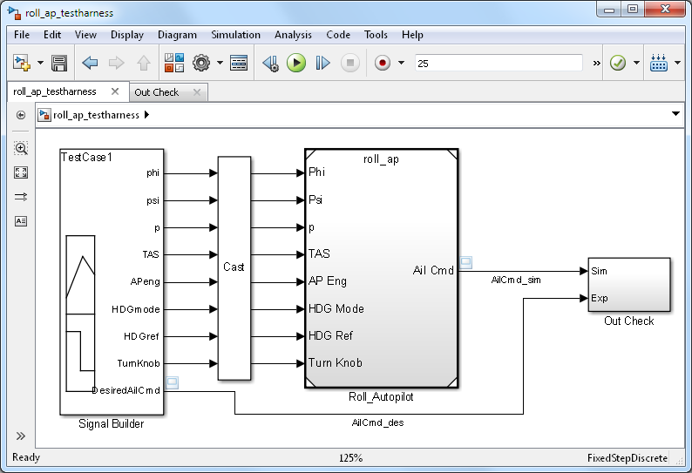
Module Test-Harness
Test Cases (Signal Builder)
Model
(Model Block)
Output Check (Assertion Block)
Test-Harness
Notes:
Three aspects of test-harness
Test Cases (Signal Budiler)
Model under test (Model Block can be used to bring sbr.mdl into the test-harness environment)
Output check (combination of relational operators and assertion block is being used)
>> sbr_testHarness
Open the Signal Builder block and explain about the assertion control
Test each test cases one by one
Error will be asserted on TC-04
Turn off the assertion and see the scope to check the difference between simulation result and expected result.
Open Model block parmeters and change sbr -> sbr_fix
Test TC-04 again and finish TC-05
Now the SBR model’s functional testing is done
It is time to talke about test automation and report generation

Slide 61
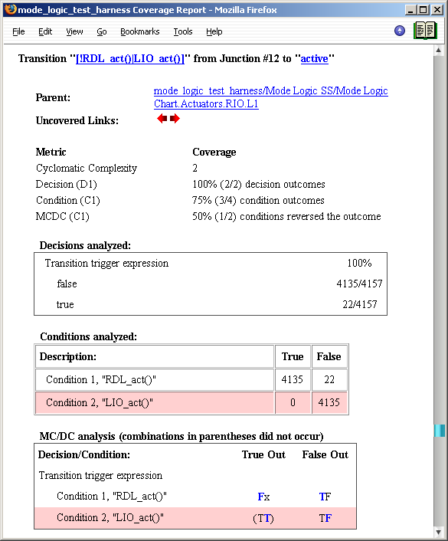
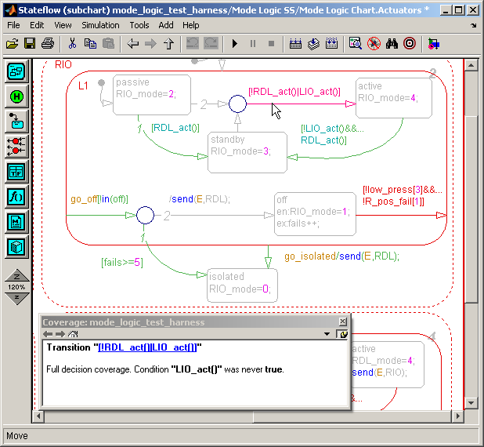
Model Coverage Measure of test completeness
Execution analysis
Based on the model structure
Dynamic – data collected during simulation
Coverage results
Displayed directly in the model
Available in a separate html report linked with the model objects
Supports:
Simulink
Stateflow
Embedded MATLAB
Decision coverage
Condition coverage
MC/DC
Lookup table coverage
Signal range coverage
Supported coverage types
Notes:
For model based design, ISO26262 directly appreciate analysis of model coverage using analoguous measures of structural coverage

Slide 62
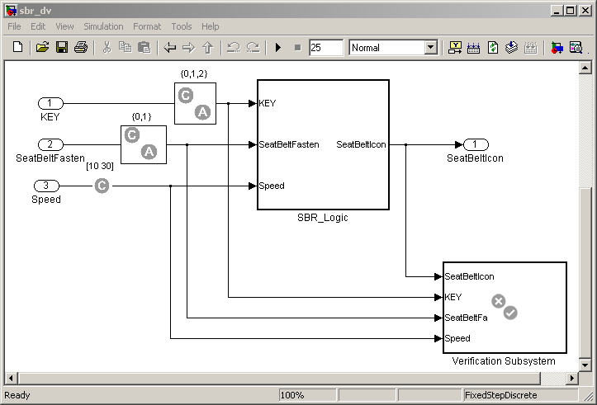
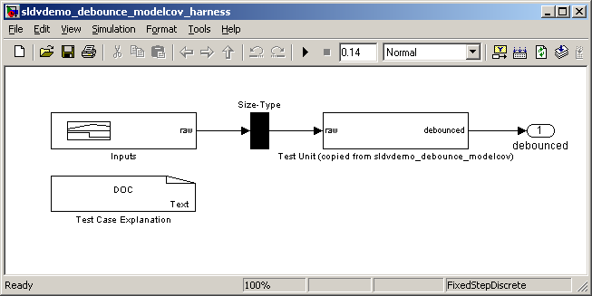
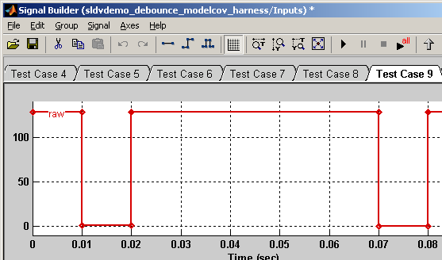
Improving Test Suite Simulink Design Verifier
Generating tests to reach coverage criteria
Test Generation
Test generation harness with the copy of the original model
Test inputs that ensure complete
coverage
Notes:
>> sbr_testGen
1) Generate test cases using DV.

Slide 63
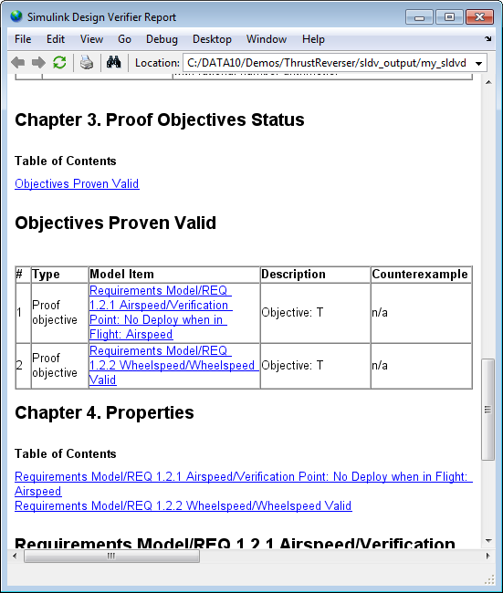
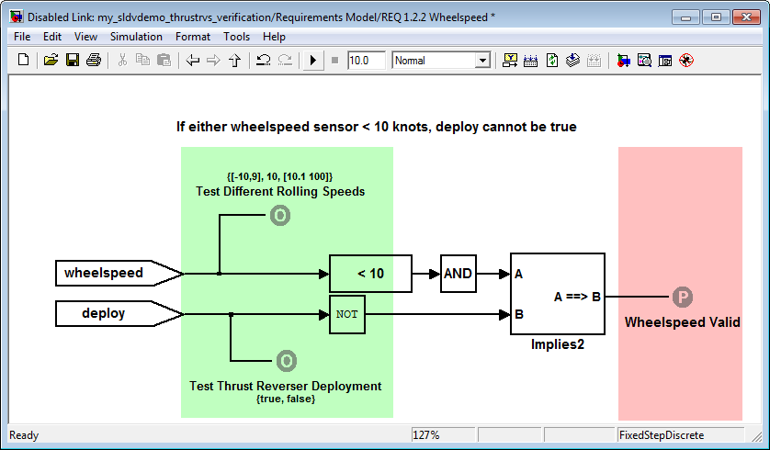
Verifying Design Against Requirements Simulink Design Verifier
Model Requirements
Prove Design Correctness
Must do
Must never do

Slide 64
Identifying Design Errors Early Simulink Design Verifier
Automatic identification of hard-to-find design inconsistencies in the model without running simulation
Integer overflow
Division by zero
Dead logic
Assertion violation
Notes:
This is new functionality in R2011a. Unlike with test generation, where simulation is used to run a number of tests and where outputs of the model need to be monitored and data analyzed in order to discover faulty behavior, as of R2011a a number of potential design problems can be detected automatically, before running simulation and before testing.

Slide 65
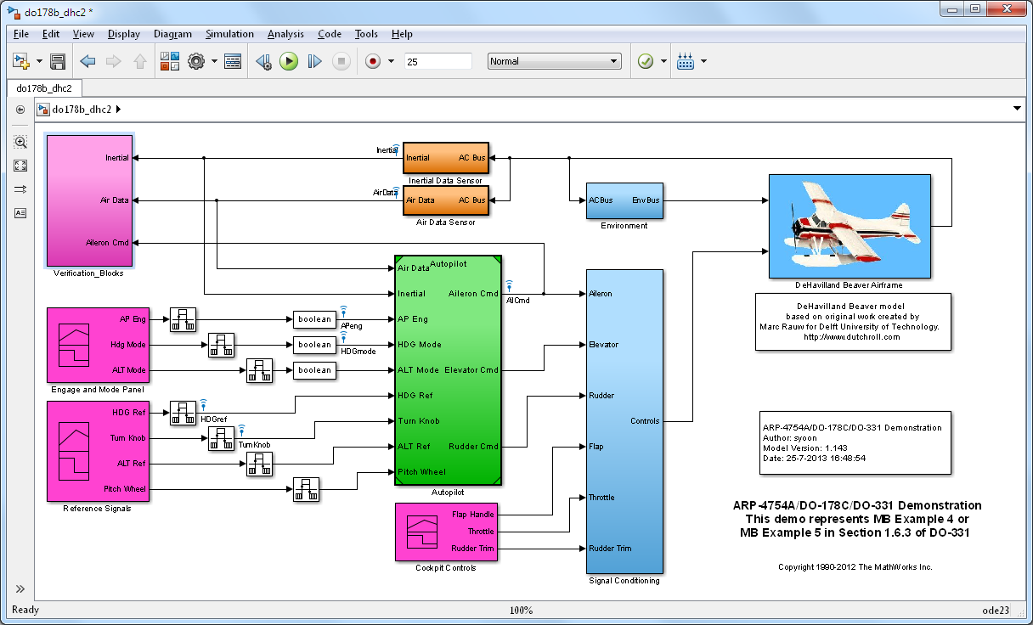
Integration Test-Harness
Output
Check
Algorithm Model
(Model Block)
Environment
Model
Test Cases (Signal Builder)
Notes:
Three aspects of test-harness
Test Cases (Signal Budiler)
Model under test (Model Block can be used to bring sbr.mdl into the test-harness environment)
Output check (combination of relational operators and assertion block is being used)
>> sbr_testHarness
Open the Signal Builder block and explain about the assertion control
Test each test cases one by one
Error will be asserted on TC-04
Turn off the assertion and see the scope to check the difference between simulation result and expected result.
Open Model block parmeters and change sbr -> sbr_fix
Test TC-04 again and finish TC-05
Now the SBR model’s functional testing is done
It is time to talke about test automation and report generation

Slide 66

Using Simulink Report Generator for Tests
Automatically document your Simulink models in multiple formats
Key Features
System Design Description (SDD)
Simulink Web Views
Multi-format reports
Model simulation within a report
Conditional documentation
Easy to share report templates
Extensible components and style sheets
Can be qualified as reporting tool for DO-178B/DO-254 projects
Notes:
Value statement:
MATLAB and Simulink Report Generators save you time and money by:
Completely automating report generation process
Enabling you to show your Simulink and Stateflow models to colleagues who may not have MathWorks products installed (this is Simulink Report Generator only)

Slide 67
3) Implementation

Slide 68
Workflow Example
* DO-178C Qualifiable Tool
Validate
Trace
SLVNV: RMI
SLRG: SDD *
Requirements
Simulink
Stateflow
SLRG: SDD *
Verify
Conformance
SLVNV: DO-178C/DO-331
Checks *
Verify
Simulink Report
Generator
SLVNV: Model Coverage *
Simulink Design Verifier
Model
Trace
Embedded Coder
Abbreviations
SL: Simulink
SLVNV: Simulink Verification and Validation
RMI: Requirements Management Interface
SDD: System Design Description
SLDV: Simulink Design Verifier
SLRG: Simulink Report Generator
PS: Polyspace
RTE: Run-Time Error
EC: Embedded Coder
PIL: Processor-in-the-Loop
Conformance
Source Code
Verify
Verify
Object Code

Slide 69
Code Generation
Requirements
Requirements
Use of Legacy Code Tool for introduction of existing C code on Simulink models
ISO ANSI-C production code generation with Embedded Coder.
Possible prototyping on target
Run-time errors verification with Polyspace before the compilation phase and execution on the target
Design
Environment
Physical Components
Algorithms
Hand- Generate
Generate
Generate
Digital Electronics
Embedded Software
VHDL, Verilog
C, C++
FPGA
ASIC
MCU
DSP
Integration
Implement

Slide 70
Simple Software Architecture
Communication
Interfaces
Comm
Drivers
Core
Software
Algorithms and Logic
Output
Drivers
Actuators
Input
Drivers
Special
Device
Drivers
Special
Interfaces
Sensors
CCP
ASAP2
Most Development is on Core Software Algorithms
Scheduler/Operating System
And Support Utilities
Notes:
A typical ECU with software has an architecture that separates the core algorithm code from the drivers, RTOS and special support software. The drivers support communication interfaces (CAN, LIN, etc), sensors , actuator control and interfacing to special tools (calibration, diagnostics, data acquisition).
The ECU software usually has a scheduler or RTOS that determines how the software should execute and respond to stimuli.

Slide 71
Interfacing Generated Code
Header Files
(e.g. Extern Var.)
Env. Code
OS/Scheduler
Device Drivers
(CAN,DIO,AIN)
- Diagnosis, etc
EC Code
Model Functions
Parameters, Data
(e.g. Global Var.)
Call Model Functions
(e.g. Model_Step())
Share entry points, data and parameters with header files
Call generated model functions from OS/Scheduler

Slide 72
Workflow Example
* DO-178C Qualifiable Tool
Validate
Trace
SLVNV: RMI
SLRG: SDD *
Requirements
Simulink
Stateflow
SLRG: SDD *
Verify
Conformance
SLVNV: DO-178C/DO-331
Checks *
Verify
Simulink Report
Generator
SLVNV: Model Coverage *
Simulink Design Verifier
Trace
Embedded Coder
Simulink Code Inspector*
Model
Trace
Embedded Coder
Abbreviations
SL: Simulink
SLVNV: Simulink Verification and Validation
RMI: Requirements Management Interface
SDD: System Design Description
SLDV: Simulink Design Verifier
SLRG: Simulink Report Generator
PS: Polyspace
RTE: Run-Time Error
EC: Embedded Coder
PIL: Processor-in-the-Loop
Conformance
Source Code
Verify
Verify
Object Code

Slide 73
Traceability
Functional Requirements
Design
Environment
Physical Components
Tracing Requirements⬄Model Simulink® Verification and Validation™
Tracing Model⬄Source Code Embedded Coder™
Tracing Requirements⬄Source Code Simulink Verification and Validation
Algorithms
Hand- Generate
Generate
Generate
Digital Electronics
Embedded Software
VHDL, Verilog
C, C++
FPGA
ASIC
MCU
DSP
Integration
Implement
Notes:
The left side of the diagram represents the design process that goes from high level requirements, and design, elaboration and implementation. All the way to deployment on the target. (click)
Traditionally, the majority of the verification and validation effort happens at the SW and SW/HW integration phase. (click)
What we are going to focus on today are methods for early verification and validation that allow you to shift a portion of your V&V effort earlier in the development and allow you to find and fix problems earlier. These early V&V methods are enabled through the use of MBD and I hope that after this sess

Slide 74


Example of HTML Report
Hyperlink within
C code files.
Hyperlink back
to model.
Hyperlink from model to code.

Slide 75


Tracing Requirements⬄Source Code Simulink Verification and Validation Embedded Coder
Including requirements in the generated source code
Notes:
Suggestion for the presenter: Highlight the key features mentioned on the slide and then talk about the benefits of requirements linking – why is this important for the customer.
Typically requirements are scattered around in different documents, whether it is a managed environment, or not. Simulink and Stateflow models are used in conjunction with these predominantly textual documents to describe the details of the design. This situation raises many challenges – models and textual documents can get out of sync, it is difficult to navigate to the right requirement, especially if there are multiple versions of it – whether it is to review the latest revision, or to write a requirement.
To address these problems Simulink Verification and Validation provides an infrastructure that allows you to link a particular document paragraph to any block, state, or transition in the model. Typically this capability is used to assign high level requirements to subsystems, or low level requirements to specific implementation details, or even component tests in Simulink.
The supported format for textual documents are… (list)
The requirements linking capability has several features that can help you review traceability between the model and the text and if RTW-EC is used for code generation, linked textual information can be propagated to the generated code in form of code comments.

Slide 76
4) Code Verification

Slide 77
Workflow Example
* DO-178C Qualifiable Tool
Validate
Trace
SLVNV: RMI
SLRG: SDD *
Requirements
Simulink
Stateflow
SLRG: SDD *
Verify
Conformance
SLVNV: DO-178C/DO-331
Checks *
Verify
Simulink Report
Generator
SLVNV: Model Coverage *
Simulink Design Verifier
Trace
Embedded Coder
Simulink Code Inspector*
Model
Embedded Coder
Abbreviations
SL: Simulink
SLVNV: Simulink Verification and Validation
RMI: Requirements Management Interface
SDD: System Design Description
SLDV: Simulink Design Verifier
SLRG: Simulink Report Generator
PS: Polyspace
RTE: Run-Time Error
EC: Embedded Coder
PIL: Processor-in-the-Loop
Conformance
Source Code
Verify
Simulink Code
Inspector*
Verify
Verify
Object Code

Slide 78

Simulink Code Inspector Automate DO-178B Code Reviews
Code
verification
Model
Source code
Independently verify that Embedded Coder generated code traces to and complies with low-level requirements
Demonstrate that model and source code match structurally and functionally
Provide model←→code traceability data
Eliminate / reduce manual code reviews for DO-178B software
Same certification credits as qualified code generator
Embedded Coder
Code traceability
Notes:
Must be suitable for customers as the slide will be made available for external use at the time of release.
Motivation
One or two sentences describing the problem in terms of how customers phrased or think of the issue. Consider both the feature and the workflow motivations.
Solution (Added Details)
More details as appropriate. How does it integrate with other features and products?
Doc Reference
In addition to release notes, which should be the source for most of the information on this slide. Add a doc reference if possible.
Demo
Shipping demo name
Limitations, Known Problems, and Workarounds
What are the current limitations? Are there problems end users are likely to run into? Are there Workarounds? Is anything likely to break, not just feature or product but interoperability with other products?
Questions and Debugging Tips (for MathWorks Support team)
What questions might end users ask?
What should Support try out when end users run into problems?
Are there any debugging tips or processes Support should follow?
Release Number – Tech Marketing to add icon closer to release date.

Slide 79
Simulink Code Inspector Overview
Model and code development
Simulink Model
C source code
Embedded Coder
Independent code inspection
Model IR
Code IR
IR transformations
Static verification tool, that checks the generated code against model
Automates DO-178B Table A-5 verification activities
Normalized Model IR
Normalized Code IR
Matching
Code inspection report
☒
?
☑
Traceability report

Slide 80
Meeting DO-178B Objectives Anticipated Certification Credits for Simulink Code Inspector with other code verification products
Code verification: Simulink Code Inspector
Code conformance: Polyspace
Model
Source code
Embedded Coder
Code traceability: Simulink Code Inspector
Annex A Table | Objective | DO-178B Ref. | Software Levels | Anticipated Certification Credit [Tool(s)]
A-5 | (1) Source Code complies with low-level requirements | Section 6.3.4a | A, B, C | Full [Simulink Code Inspector]
A-5 | (2) Source Code complies with software architecture | Section 6.3.4b | A, B, C | Full [Simulink Code Inspector]
A-5 | (3) Source Code is verifiable | Section 6.3.4c | A, B | Full [Simulink Code Inspector, Polyspace dead code analysis]
A-5 | (4) Source Code conforms to standards | Section 6.3.4d | A, B, C | Full [Polyspace MISRA-AC ACG rules checker]
A-5 | (5) Source Code is traceable to low-level requirements | Section 6.3.4e | A, B, C | Full [Simulink Code Inspector]
A-5 | (6) Source Code is accurate and consistent | Section 6.3.4f | A, B, C | Full (for source code based criteria) [Simulink Code Inspector, Polyspace verifier]

Slide 81
Structural Verification of Generated Code Summary
Automates DO-178B Verification Activities
Source Code Traces to Model
Source Code Complies with Model
Eliminates / reduces manual code reviews
Can be qualified as a verification tool
Implemented independent of Embedded Coder
→ Same benefits as Qualified Coder Generator
→ Allows to profit from state-of-the-art code generation using Embedded Coder

Slide 82
Workflow Example
* DO-178C Qualifiable Tool
Validate
Trace
SLVNV: RMI
SLRG: SDD *
Requirements
Simulink
Stateflow
SLRG: SDD *
Verify
Conformance
SLVNV: DO-178C/DO-331
Checks *
Verify
Simulink Report
Generator
SLVNV: Model Coverage *
Simulink Design Verifier
Trace
Embedded Coder
Simulink Code Inspector*
Model
Conformance
PS:MISRA-C
Checks *
Embedded Coder
Abbreviations
SL: Simulink
SLVNV: Simulink Verification and Validation
RMI: Requirements Management Interface
SDD: System Design Description
SLDV: Simulink Design Verifier
SLRG: Simulink Report Generator
PS: Polyspace
RTE: Run-Time Error
EC: Embedded Coder
PIL: Processor-in-the-Loop
Conformance
Source Code
Verify
Simulink Code
Inspector*
Verify
Verify
Object Code

Slide 83
Proving Code Correctness
Requirements
Requirements
Design
Environment
Verifying code integration
Certification requirements
Reliability concerns
Physical Components
Algorithms
Hand- Generate
Generate
Generate
Digital Electronics
Embedded Software
Proving Code Correctness Polyspace Server for C/C++
VHDL, Verilog
C, C++
FPGA
ASIC
MCU
DSP
Integration
Implement

Slide 84
Runtime Errors
Arithmetic errors
Found in (code)
Overflows, division by zero, bit-shifts, square root of negative numbers
Caused by (model)
Faulty scaling, changes in or unknown calibrations, untested data ranges coming out of a subsystem into an arithmetic block
Memory corruption
Found in (code)
Out of bound array indexes
Pointer arithmetic
Caused by (model)
Array manipulation in Stafeflow
Hand-written look-up table functions
Data truncation
Found in (code)
Overflows
Wrap around
Caused by (model)
Saturations leading to unexpected data flow inside the generated code
Coding errors
Found in (code)
Non initialized data
Dead code leading to unreachable transitions or states
Caused by (model)
Faulty Stateflow programming

Slide 85

Polyspace products for code verification
Quality
Prove the absence of run-time errors in source code
Measure, improve and control
Usage
Simple colored source code
No execution or test cases
For C/C++ or Ada
Process
Use early in development
For automatically generated and handwritten code
Notes:
So concretely, what does this product offer on run-time error
Simple: a colored source code to trace the root-cause analysis of run-time errors.
Green, the most important colors, means the code is reliable. Proven correct
Red: always a fault
Gray: dead code
Orange: unproven. Might be a problem, might not.
And when I say proven, we can prove that to certification authorities I’ll mention later.
This being said, this product is about
Quality improvement:
it gives you some means to measure, improve and control. In the goal of Proving the absence of errors
Of course you don’t start with 100% green, but it’s a tool that gives you the choice of the right level of green to target.
Using the tool is simple
The results are in 4 colors for C/C++ and Ada
And the product does not require compilation, execution, or any test-cases: it’s automatic
In terms of process
I’m not talking about a magic tool you put at the end of your process, hoping to prove that there are no errors left. No
It’s about having a quality product as an integral part of your software life cycle.: use it early. And I’ll show you how later
Finally, it works for hand-code and automatically generated code

Slide 86


Tracing results back to the model Polyspace™ Model Link SL
Integrates code verification with the production code generation

Slide 87

Code Analysis Result
Polyspace Viewer
Notes:
Only result is shown here for the SBR code.
- One orange exist due to the code’s interface requirement using pointer as the output.

Slide 88
Proving Code Correctness Polyspace Server for C/C++
Authoring
Configuration - selection of code base and types of problems to focus on
Execution and Reporting
Runtime benchmark for both generated and legacy code
Benefits
Detects hard-to-find runtime problems
Increases confidence by proving absence of runtime errors
Helps with independent verification for certification purposes
Notes:
Make sure to mention “model coverage” or structural coverage
Complete coverage -> Need to mention that desired coverage level is pre-defined and then achieved with help of SLDV.

Slide 89
Workflow Example
* DO-178C Qualifiable Tool
Verify
EC: PIL
Simulink Report Generator
Polyspace*
Validate
Trace
SLVNV: RMI
SLRG: SDD *
Requirements
Code Coverage
Tool
Simulink
Stateflow
SLRG: SDD *
Verify
Conformance
SLVNV: DO-178C/DO-331
Checks *
Verify
Simulink Report
Generator
SLVNV: Model Coverage *
Simulink Design Verifier
Trace
Embedded Coder
Simulink Code Inspector*
Model
Conformance
PS:MISRA-C
Checks *
Verify
EC: PIL
Simulink Report Generator
Polyspace*
Embedded Coder
Abbreviations
SL: Simulink
SLVNV: Simulink Verification and Validation
RMI: Requirements Management Interface
SDD: System Design Description
SLDV: Simulink Design Verifier
SLRG: Simulink Report Generator
PS: Polyspace
RTE: Run-Time Error
EC: Embedded Coder
PIL: Processor-in-the-Loop
Source Code
Verify
Simulink Code
Inspector*
Verify
Code Coverage
Tool
Verify
Compiler/IDE
Object Code

Slide 90
Code Testing
Functional Requirements
Design
Environment
Model Testing
SystemTest™
Simulink Verification and Validation
Simulink® Design Verifier™
Physical Components
Algorithms
Verify that design meets requirements
Hand- Generate
Generate
Generate
Digital Electronics
Embedded Software
Code Testing
Embedded Coder
VHDL, Verilog
C, C++
FPGA
ASIC
MCU
DSP
Verify that the behavior of source code and object code matches the model
Integration
Implement
Notes:
Code Testing
Real-Time Workshop Embedded Coder
Embedded IDE Link ™ products (for Altium® TASKING® or TI's Code Composer Studio™, etc.)
Target Support Package ™ products (for Infineon® C166® or Freescale™ MPC5xx, etc.)

Slide 91


Software-in-the-Loop (SIL) Testing: Verify Production Controller with Software-in-the-loop
Code
Generation
Execution
Host/Host
Nonreal-time
Compiled C Code
S-Function
(Windows DLL)
Notes:
>> sbr_testHarness_SiL

Slide 92



Processor-in-the-Loop Testing: Verify Production Controller with Processor-in-the-loop
Code
Generation
Execution
Host/Target
Nonreal-time
Production Processor
Notes:
Embedded IDE Link for TS has been used(C167)
>> sbr_testHarness_PiL

Slide 93
Summary of MathWorks Tool Chain
xPC TargetTM
Simulink® CoderTM
Simulink®
Stateflow®
Simulink® Design VerifierTM
Requirements
Simulink®
SystemTestTM
Simulink® Validation
VerificationTM (RMI)
Simulink® Design VerifierTM
Embedded CoderTM (PIL)
Stateflow®
Simulink® Validation VerificationTM (MC)
SystemTestTM
Simulink® Report GeneratorTM (SDD)
Simulink® Validation
VerificationTM (MA)
Polyspace® ( RTE)
Models
Code coverage
Simulink® Code InspectorTM
Embedded CoderTM (PIL)
Embedded CoderTM
Simulink® Code InspectorTM
SystemTestTM
Polyspace® (MISRA, RTE)
Polyspace® ( RTE)
Validate
C code
Verify
Trace
Compile & Build
Abbreviations
DV: Simulink Design Verifier
MA: Model Advisor
MC: Model Coverage
RMI: Requirements Management Interface
RTE: Run-Time Error
PIL: Processor-in-the-Loop
SDD: System Design Description
VV: Verification and Validation
Develop
DO Qualification Kit
EOC
Notes:
Points clés:
La solution intègre des outils de développement, de vérification et des kits pour permettre la qualification d’outils.
La solution couvre en grande partie du développement logiciel. Les parties modèles et code source sont totalement couvertes
La solution s’étend au-delà du logiciel embarqué avec la possibilité de simuler au niveau système et de générer du code HDL

Slide 94
DO Qualification Kit
Notes:
[Timing: 15 minutes for Intro]

Slide 95

DO-178B Qualification Kit (1/3)
Tool Qualification Plan and Tool Operational Requirements
Test case models and code, test procedures, and expected results
Traceability tables mapping test cases to requirements
Qualification materials for Simulink Verification and Validation, and SystemTest tools
Qualification materials for Polyspace code verification tools

Slide 96



Tool Qualification Plan and Operational Requirements (2/3)
DO Qualification Kit 1.5 contains qualification artifacts for the following products:
Simulink Verification and Validation
DO-178B Model Advisor Checks
Model Coverage
SystemTest
Limit Test Element
Polyspace verification products
Polyspace Client for C/C++
Polyspace Server for C/C++
Simulink Report Generator
System Design Description

Slide 97
DO-178B Qualification Kit summary (3/3)
DO Qualification Kit:
Eases your embedded system certification process
Helps satisfy the objectives of verification tool qualification described in DO-178B (Section 12.2)
Facilitates automated software verification for DO-178B
Enables use of state-of-the-art development tools for Model-Based Design with flight code generation
Enables qualification of PolySpace products, including formal analysis capabilities

Slide 98
Customer Stories
Notes:
[Timing: 15 minutes for Intro]

Slide 99
ARP 4754A: System Engineering for Everyone
Systems
ARP 4754
Software
DO-178
Hardware
DO-254

Slide 100







User Stories for Certified Commercial Aircraft
DO-178
DO-254
ARP-4754
.
Honeywell USA
Integrated Avionics
Airbus UK and France
Fuel Management Systems
BAE USA and UK
Flight Control Systems
DO-178
DO-178
DO-178
Eurocopter France
Air Conditioning
EADS USA and France
Motor Drive Unit
Bell Helicopter USA
Civilian Tiltrotor
Notes:
100

Slide 101



Selex Flight Systems (March 2013)
Motor Control
MATLAB
Simulink
Systems
Embedded
Coder
HDL Coder
Doppler Radar
Software
Hardware
PIL
FIL
HIL
http://www.mathworks.com/tagteam/75977_Concepts_to_Chips_SELEX_ES.pdf

Slide 102

http://www.mathworks.com/tagteam/75977_Concepts_to_Chips_SELEX_ES.pdf

Slide 103


Northrop Grumman – Code Generation History (1997)
http://www.mathworks.com/aerospace-defense/aerodef_conf07/proceedings/MADC_2007_10_Miller_NGC.pdf

Slide 104



Honeywell Avionics – FAA Tools Forum (2004)
http://www.mathworks.ch/company/newsletters/aero_digest/aug04/Honeywells.pdf

Slide 105


Lockheed Martin – F-35 JSF Flight Code from Embedded Coder (2004)
MathWorks 2004 Aerospace User Conference
www.mathworks.com/industries/aerospace/miadc/symposium.html

Slide 106
Bell Helicopter Develops the First Civilian Tiltrotor, Using Model-Based Design (2006*)
Challenge
Design and build the BA609, the first and fastest commercially available tiltrotor aircraft in the world
Solution
Use Model-Based Design with MATLAB, Simulink, and Simulink Coder to model, simulate, test, and verify designs
Results
Full collaboration with suppliers via Simulink models
Flight control system code generated automatically from models
40% improvement in design and development time
Flawless first flight, which went exactly like the simulation
The BA609, flying in airplane mode.
"Simulations and a rapid, iterative approach enabled us to minimize the unknowns and ensure that we had established enough margin that when we ran into a surprise we could continue to have a safe flight test program—and run it with unprecedented efficiency.”
David King Bell Helicopter
Link to article
Notes:
Primary Industry: Aerospace and Defense
Secondary Industries: n/a
Application Areas: Algorithm Development, Control Design, Hardware-in-the-Loop (HIL)
Products Used: MATLAB, Simulink, Control System Toolbox, MATLAB Coder, Simulink Coder
Country: USA
Article published in The MathWorks News & Notes, October 2006

Slide 107
Design Times at Honeywell Cut by 60% (1998*)
Challenge
Update a flight control system while reducing development time and costs
Solution
Use design tools from MathWorks to enable one team to design, model, and simulate the flight-control laws and automatically generate flight-ready code
Results
A five-to-one improvement in productivity
Highly accurate, reusable code
A superior product
“[Using Simulink and Simulink Coder] we found we could do in half a day what previously took a week or more… It is pretty easy to see at least five-to-one improvement over the way we used to work.”
Wayne King
Honeywell Commercial Aviation Systems
Link to user story
Notes:
Primary Industry: Aerospace and Defense
Secondary Industries: n/a
Application Areas: Control Design
Products Used: MATLAB, Simulink, Embedded Coder, MATLAB Coder, Simulink Coder
Country: USA
Design Times at Honeywell Cut by 60%
The Challenge
Honeywell’s Commercial Aviation Systems (CAS) division set out to strengthen its position as the world-leading supplier of avionics systems for business and commuter aircraft. Their strategy involved updating their flagship product, the Primus series flight-control system.
“In our business we have pretty low volume, and our nonrecurring costs are very high,” says Bill Potter, staff engineer at CAS. The upgrade had to be accomplished within a framework of reducing development time and costs. This meant “put[ting] emphasis on improving the development process.”
The design process at CAS had previously moved through a traditional cycle in which engineers specify what the software is supposed to do and then a programmer interprets those specifications and writes the code. This procedure was not only time-consuming and error-prone; it also tended to put the code out of sync with the engineers’ original specification and intent.
“[Using Simulink and Embedded Coder] we found we could do in half a day what previously took a week or more … It is pretty easy to see at least a five-to-one improvement over the way we used to work.”
- Wayne King, Honeywell
The Solution
Honeywell began exploring the latest design tools from MathWorks. By using new technology, they hoped to enable one team to design, model, and simulate the flight control laws, automatically generate flight-ready code based on the engineers’ intent, and reuse the highly modular code in other designs.
“We took our old designs and converted them to MATLAB,” said Potter. This had one immediate effect, he added: “We actually uncovered a whole bunch of errors in our old documentation.”
Their success with MATLAB® led CAS to try Simulink® for modeling, simulation, and verification, a move that quickly proved valuable, with shorter design times and fewer iterations.
“It is really easy for us, when we find a problem, to analyze Simulink models and come up with options. We have it modularized. It’s a huge time saver. It’s very fast,” said Wayne King, CAS principal engineer.
The next step was to create control code for the flight controller. Nearly 60% of the code for the upgraded Primus series was generated by Embedded Coder™ from a Simulink model. It was an easy matter to integrate the new code with code that had been written before, which meant that no existing code was wasted and that there was no duplication of effort.
Engineers found that the new development process had a positive effect on documentation as well. Once they switched to Simulink and Embedded Coder, it was easier to keep documentation in step with software development because control code was now drawn essentially from the specification itself. King recalled that once they switched over to Simulink and Embedded Coder, they were forced to update the drawings in Simulink and then generate the code from that, which meant that the specs and the code were always in sync.
The Results
■ A five-to-one improvement in productivity. “[Using Simulink and Embedded Coder] we found we could do in half a day what previously took a week or more,” said King. “It is pretty easy to see at least a five-to-one improvement over the way we used to work.”
■ Highly accurate, reusable code. “We’ve never seen a coding error from Embedded Coder,” King said. “It always produces reliable, quality code. It always works as we designed. It’s been a big benefit to us.” Potter added, “We are planning to get substantial reuse of the engineers’ work. We’ll have a baseline that can be modified to fit the new customers’ needs.”
■ A superior product. The revamped flight control system passed all flight tests and received Federal Aviation Administration certification in July 1998. In November 1998, the Primus Epic™ was named as the standard avionics system for the Hawker Horizon business jet from Raytheon Aircraft.
Learn more about Honeywell: www.honeywell.com

Slide 108
Airbus Develops Fuel Management System for the A380 Using Model-Based Design (2013*)
Challenge
Develop a controller for the Airbus A380 fuel management system
Solution
Use MATLAB, Simulink, and Stateflow for Model-Based Design to model and simulate the control logic, communicate the functional specification, and accelerate the development of simulators
Results
Months of development time eliminated
Models reused throughout development
Additional complexity handled without staff increases
Airbus A380, the world’s largest commercial aircraft.
“The Simulink and Stateflow models enabled us to validate requirements early and communicate the functional specification to our suppliers, complementing the written requirements in conformance with ARP 4754.”
Christopher Slack Airbus
Link to user story
Notes:
Primary Industry: Aerospace and Defense
Secondary Industries: N/A
Product Capabilities: Mathematical modeling, Algorithm development, Parallel computing, System design and simulation, Physical modeling, Verification, validation, and test
Applications: Embedded systems, Control systems, Digital signal processing
Products Used: MATLAB, Simulink, Curve Fitting Toolbox, MATLAB Distributed Computing Server, Parallel Computing Toolbox, Signal Processing Toolbox, SimPowerSystems, Simulink Coder, Stateflow, System Identification Toolbox
Country: United Kingdom
Airbus Develops Fuel Management System for the A380 Using Model-Based Design
The Airbus A380, the largest commercial aircraft currently in operation, has a range of more than 8,000 miles. To enable such long non-stop flights, the A380’s 11 fuel tanks have a capacity of 250 metric tons (320,000 liters).
The A380’s sophisticated fuel management system handles fueling and defueling operations on the ground, as well as fuel flow to engines and between tanks while airborne. The system can move fuel between tanks to optimize the aircraft’s center of gravity, reduce wing bending, and keep fuel within the acceptable temperature range.
Airbus engineers used Simulink® and Stateflow® to develop a model of the fuel management system that was reused throughout the project. “With Model-Based Design, the model we used to represent the functional specification enabled us to validate requirements months earlier than was previously possible,” says Christopher Slack, computational analysis expert in fuel systems at Airbus.
The Challenge
The A380’s fuel management system must be able to safely handle any failure in the system’s 21 pumps, 43 valves, and other mechanical components. In a complex system, it’s challenging for engineers at the requirements stage to predict any problem that can result from combinations of relatively minor failures.
The fuel system specification document for the A380’s predecessor, the A340, had over a thousand written requirements. “Text requirements can leave room for ambiguity and misinterpretation. When you have that many requirements, it’s difficult for anyone to understand all the possible interactions between them and identify, for example, that a requirement on page 20 conflicts with one on page 340,” says Slack.
“Model-Based Design gave us advanced visibility into the functional design of the system. We also completed requirements validation earlier than was previously possible and simulated multiple simultaneous component failures, so we know what will happen and have confidence that the control logic will manage it.”
- Christopher Slack, Airbus
The Solution
Airbus used Model-Based Design to model the A380’s fuel management system, validate requirements through simulation, and clearly communicate the functional specification.
Airbus engineers used Simulink and Stateflow to model the system’s control logic, which comprises 45 top-level charts, almost 6000 states, and more than 8700 transitions. This model defines modes of operation on the ground (including refuel, defuel, and ground transfer) and in flight (including normal engine feed, center of gravity control, load alleviation, and fuel jettison).
The functionality within each top-level mode is grouped into subcharts, enabling engineers to work independently on individual components in the hierarchy.
The team developed a parameterized plant model of the tanks, pumps, valves, and electrical components using Simulink. Engineers can set parameter values to configure this model to represent fuel systems for any Airbus aircraft.
After running closed-loop simulations of individual operational components in Simulink, the team integrated them into a complete model for system-level simulations.
Using Parallel Computing Toolbox™ and MATLAB Distributed Computing Server™, the team performed Monte Carlo simulations on a 50-worker computing cluster. Over a weekend, they can run 100,000 simulated flights under varied environmental conditions and aircraft operational scenarios.
The team created a desktop simulator by generating code from the plant and control logic models with Simulink Coder™. A MATLAB® based user interface enables suppliers, airline customers, maintenance engineers, and other Airbus teams to visualize how the fuel management system works and interacts with other aircraft systems.
The team also used the Simulink models to develop hardware-in-the-loop (HIL) tests and commission their HIL testing rig well before the real hardware was available.
After successful flight tests of the A380, the team used System Identification Toolbox™ to tune their plant model using measured flight test data. They used Signal Processing Toolbox™ to remove noise from the test data, and Curve Fitting Toolbox™ to evaluate differences between the measured data and predicted results and to predict system performance beyond the usual flight envelopes. While refining the plant model, they used SimPowerSystems™ to incorporate relays and other elements of the electrical power system.
Based on the success of implementing Model-Based Design for the A380, Airbus engineers are now using this approach to develop the Airbus A350XWB’s fuel management system, reducing development time of this aircraft by one year.
The Results
■ Months of development time eliminated. “On earlier projects, it took up to nine months to integrate our fuel system design with the simulated cockpit, or iron bird. Using Model-Based Design on the A380, it took less than a month,” says Slack. “Similarly, by reusing the model to commission the HIL rig, we saved three months of development and shortened the time from initial concept to first flight.”
Models reused throughout development. “The Simulink and Stateflow models enabled us to validate requirements early and communicate the functional specification to our suppliers, complementing the written requirements in conformance with ARP 4754,” says Slack. “These models were reused to create desktop simulators, commission our HIL test rig, run on our virtual integration bench, and demonstrate system functionality to customers.”
Additional complexity handled without staff increases. “The fuel system of the A380 is three to four times more complex than that of the A340,” notes Slack. “Model-Based Design enabled us to handle a substantially more complex project with the same size engineering team.”
Learn more about Airbus: www.airbus.com

Slide 109

Eurocopter Accelerates Development of DO-178B Certified Software with Model-Based Design (2013)
Challenge
Speed the development, validation, and verification of DO-178B certified helicopter flight software
Solution
Use Model-Based Design to model the system design and software design, and to generate flight code
Results
Software testing time cut by two-thirds
Requirements stabilized earlier
Certified flight software automatically generated
The Eurocopter EC130 helicopter.
“We use our system design model in Simulink for ARP4754 to establish stable, objective requirements. We save time by using the model as the basis for our software design model for DO-178—from which we generate flight code—and reusing validation tests for software verification.”
Ronald Blanrue Eurocopter
Link to user story
Notes:
Industries: Aerospace and defense
Application Areas: Embedded systems, Control systems
Capabilities: Algorithm development, System design and simulation, Embedded code generation, Verification, validation, and test
Products Used: Simulink, Embedded Coder, Simulink Verification and Validation
Country: France
Eurocopter Accelerates Development of DO-178B Certified Software with Model-Based Design
Building software for aircraft in compliance with DO-178B, DO-178C, and ARP4754 guidelines presents several challenges. After developing a formal Plan for Software Aspects of Certification (PSAC) and having it approved by the European Aviation Safety Agency (EASA), the software development organization must rigorously follow that plan and then demonstrate that it has done so before receiving certification. These challenges are often compounded by changing, or poorly communicated, system and software specifications.
Engineers at Eurocopter use Model-Based Design to accelerate development and to stabilize system and software specifications. Based on textual requirements, they model the software architecture, system design, and software design in Simulink®, and then use Embedded Coder® to generate code for flight software, including an air conditioning control system (with bi-zone temperature, demisting, and defrosting) aboard Eurocopter EC130 helicopters.
“Simulink enables us to stabilize our requirements and specification as early as possible because we develop the specification and the design concurrently,” says Ronald Blanrue, avionic certification specialist at Eurocopter. “We validate the requirements and specification with the Simulink model, and then reuse the model to generate code with Embedded Coder.”
Challenge
Before beginning development, Eurocopter needed a comprehensive certification strategy, which included identifying the necessary software development and verification tools. The company would then present this plan to EASA for their review and approval.
As a mature development organization, Eurocopter rarely encountered difficulties with coding or testing; rather, their problems stemmed from difficulties in stabilizing the specification. Engineers sometimes misinterpreted the requirements and implemented a system that behaved correctly but not as intended. In fact, the company estimated that up to 90% of problems discovered late in development were due to errors in the specification and design, not the source code. Eurocopter wanted to stabilize and validate requirements early in the development workflow for DO-178B certified software.
“We use our system design model in Simulink for ARP4754 to establish stable, objective requirements. We save time by using the model as the basis for our software design model for DO-178—from which we generate flight code—and reusing validation tests for software verification."
- Ronald Blanue, Eurocopter
Solution
Eurocopter developed a PSAC based on Simulink, Simulink Verification and Validation™, and Embedded Coder for its EC130 air conditioning software.
They used Simulink to model the system design for ARP4754. To validate the specification, they conducted functional tests of this model and a behavioral plant model, also built in Simulink.
They reused the system model, adding detail to create the software design for DO-178B. The tests that the team had created for the system design were enhanced and reused to verify the software design.
The team used Simulink Verification and Validation to check compliance with DO-178B modeling standards. They also checked custom modeling guidelines, for example for incorporating legacy C code into the model with S-functions.
Model coverage reports from Simulink Verification and Validation enabled the team to identify elements of the design or specification that were not covered by their tests. Though the reports were not submitted for certification credit, the coverage analysis helped the team create a complete test suite for the object code, which was used for certification.
Using Embedded Coder, Eurocopter engineers generated C code from the software design model. After conducting a code review using model-to-code bidirectional navigation links generated by Embedded Coder, the team compiled and tested the generated code. To help achieve the software verification (including code coverage), they again reused the tests cases that they had used for validation and verification of the Simulink model.
The software was certified to DO-178B DAL C by EASA and is currently in production on EC130 helicopters.
Results
■ Software testing time cut by two-thirds. “We used to spend weeks testing the software, but with Model-Based Design it takes just a few days,” says Thomas Gelas, design engineer at Eurocopter. “We have shifted much of our testing effort to validation activities, which enables us to identify and resolve problems earlier in development.”
■ Requirements stabilized earlier. “With Simulink we validate the specification with the design model and then reuse it to model the software. No other process improvement has saved us as much time as rapid stabilization of our specification,” says Blanrue. This approach could enable Eurocopter to freeze the specification up to a year earlier compared with previous multiyear projects.
■ Certified flight software automatically generated. “Our negotiations with the certification authority were positive because EASA is seeing more companies that rely on models for software development and recognize the value of modeling,” says Blanrue. “After completion of a code review, EASA certified the flight software that we built with code generated by Embedded Coder to DO-178B.”
Learn more about Eurocopter: www.eurocopter.com

Slide 110



NASA – 50% of NASA Projects Use Simulink Generated Code
http://ti.arc.nasa.gov/m/profile/edenney/papers/Denney-BigSky-08.pdf
http://www.mathworks.com/company/newsletters/articles/accelerating-nasa-gnc-flight-software-development.html

Slide 111




NASA – GN&C Standards
http://www.mathworks.com/aerospace-defense/standards/nasa.html

Slide 112


BAE Systems The MathWorks tools now form the building blocks of our model-based design process

Slide 113



UK Aerodef– High Integrity Standards
http://www.mathworks.com/aerospace-defense/standards/uk-aerospace-defense.html

Slide 114
Recent Certifications

Slide 115

India – August 2013
National Aerospace Laboratories Proves Benefits of Model-Based Design for DO-178B Flight Software Development
Challenge
Accelerate the development of DO-178B
Level A certified flight software
Solution
Complete a stall warning system pilot project using Simulink and Embedded Coder, quantify improvements in development efficiency, and adopt Model-Based Design for future DO-178 projects
Results
Code analysis and design time cut in half
Tradeoffs Integrated workflow established
Consistent, high-quality code generated
SARAS, CSIR-NAL’s multirole light transport aircraft.
“Simulink and Model-Based Design reduced the effort needed to upgrade functionality, code analysis time, and design time for the safety-critical embedded system. The compatibility of Simulink with the DO-178 process gave us confidence to use Model-Based Design for our upcoming DO-178 projects.”
Manju Nanda CSIR-National Aerospace Laboratories
Link to user story
Notes:
Industries: Aerospace and defense
Application Areas: Embedded systems, Control systems
Capabilities: Algorithm development, System design and simulation, Embedded code generation, Verification, validation, and test
Products Used: MATLAB, Simulink, DO Qualification Kit for DO-178, Embedded Coder, Simulink Design Verifier, Simulink Report Generator, Simulink Verification and Validation, Stateflow
Country: India
National Aerospace Laboratories Proves Benefits of Model-Based Design for DO-178B Flight Software Development
National Aerospace Laboratories is the only government aerospace R&D laboratory in India’s civilian sector. Established by the Council of Scientific and Industrial Research, CSIR-NAL has a threefold mandate: develop aerospace technologies with strong science content, design and build small and medium-sized civil aircraft, and support all national aerospace programs.
As part of this mandate, CSIR-NAL developed SARAS, a 14-seat, multirole light transport aircraft. SARAS is equipped with a state-of-the-art stall warning system and aircraft interface computer (SWS/AIC) that alerts pilots when the plane is in danger of stalling. Recently, CSIR-NAL engineers completed a SWS/AIC pilot project in which they quantified the advantages of Model-Based Design over their conventional approach for DO-178B Level A software development. Among other benefits, they found that Model-Based Design with MATLAB® and Simulink® reduced the effort needed to upgrade functionality by 75%.
“In the past, functional upgrades required manual iterations for design changes, code modifications, retesting, and report generation,” says J. Jayanthi, senior principal scientist at CSIR-NAL. “With Model-Based Design, upgrades become simple because the links between requirements, model, code, tests, and reports have already been established. We just make changes at the model level and everything—including the generated code—falls into place.”
Challenge
CSIR-NAL initially implemented the SARAS SWS/AIC system by hand-coding the algorithms in C. Although the software was ultimately certified to DO-178B Level A, the effort took longer than planned. The team attributed the delays to gaps between the requirements, the implemented code, and the tests conducted for verification. To bridge these gaps, the team had to perform numerous manual activities, including tracing code back to requirements, performing coverage analysis, and producing the documentation necessary for certification.
CSIR-NAL engineers sought to automate these manual activities within a workflow that incorporated their existing tools for requirements management and testing.
“Simulink and Model-Based Design reduced the effort needed to upgrade functionality, code analysis time, and design time for the safety-critical embedded system. The compatibility of Simulink with the DO-178 process gave us confidence to use Model-Based Design for our upcoming DO-178 projects."
- Manju Nanda, CSIR-National Aerospace Laboratories
Solution
CSIR-NAL engineers completed the SWS pilot project using Simulink, Stateflow®, and Embedded Coder®.
They designed the SWS in Simulink, using Stateflow to model decision logic.
As they developed the model, they adhered to MathWorks Automotive Advisory Board (MAAB) and DO-178B high-integrity modeling standards. They used the model standards checks in Simulink Verification and Validation™ to ensure compliance with the standards.
CSIR-NAL engineers used Simulink Design Verifier™ to generate test cases from the Simulink and Stateflow model and to perform model coverage analysis while running simulations to execute the tests.
The team generated about 5000 lines of C code from their model using Embedded Coder. For each SWS subsystem, they compared the generated code with the code that they had handwritten for the initial implementation.
With Simulink Verification and Validation, the engineers linked elements of the SWS model with requirements in Microsoft® Word. The generated code included requirements labels as comments, enabling them to trace requirements to the model and the final code.
The team took advantage of the integration between Simulink and the LDRA tool suite to streamline code coverage analysis and other software-level testing activities, and to establish traceability between the model and test cases.
Finally, the team used Simulink Report Generator™ to document the model and code coverage results required for certification credit.
Based on the success of the pilot project, CSIR-NAL plans to use Model-Based Design for future DO-178B and DO-178C Level A projects.
Results
■ Code analysis and design time cut in half. “For the SWS pilot project we gathered metrics for comparison with our conventional approach,” says Manju Nanda, principal scientist. “In addition to a 75% reduction in the effort needed to upgrade functionality, we saw a 48% reduction in code analysis time and a 50% reduction in design time with Model-Based Design, enabling us to do more with fewer people.”
■ Integrated workflow established. “With Model-Based Design we have a well-defined DO-178 workflow that integrates with our existing tools,” says Jayanthi. “We can trace requirements in Word or Telelogic® DOORS® to Simulink models, generated code, and code-level tests in LDRA. And we can use Simulink Report Generator and DO Qualification Kit for DO-178 certification.”
■ Consistent, high-quality code generated. “The code generated with Embedded Coder was as good as our handwritten code, and often more compact as well,” says Jayanthi. “We can trace the code back to our model and requirements, and because it was generated from our model, it was more consistent and significantly easier to maintain than handwritten code.”
Learn more about CSIR-National Aerospace Laboratories: www.nal.res.in

Slide 116
Italy – September 2013
Alenia Aermacchi Develops Autopilot
Software for DO-178B Level A Certification
Challenge
Develop the company’s first DO-178B Level A certified autopilot system
Solution
Use Model-Based Design to model the system and software design, verify requirements coverage, generate code, and produce reports and other artifacts for the certification authority
Results
Requirements review for certification up to 30% shorter
Time-to-flight reduced by 20%
Low-level certification activities automated
The Alenia Aermacchi M-346.
“For us, a key advantage of Model-Based Design is the ability to concentrate on design and development instead of low-level coding, verification, and certification tasks. The result is higher quality, DO-178B certified software, and faster iterations.”
Massimiliano Campagnoli Alenia Aermacchi
Link to user story
Notes:
Industries: Aerospace and defense
Application Areas: Embedded systems, Control systems
Capabilities: Algorithm development, System design and simulation, Embedded code generation, Verification, validation, and test
Products Used: Simulink, DO Qualification Kit, Embedded Coder, Polyspace Bug Finder, Polyspace Code Prover, Simulink Report Generator, Simulink Verification and Validation, Stateflow
Country: Italy
Alenia Aermacchi Develops Autopilot Software for DO-178B Level A Certification
With flight characteristics similar to the latest fighter aircraft, the Alenia Aermacchi M-346 enables pilots to train safely in an aircraft with low life-cycle costs. Equipped with four redundant computers, the M-346 flight control system (FCS) supports fly-by-wire control and advanced autopilot capabilities.
Alenia Aermacchi used Model-Based Design to develop the autopilot software and certify it to DO-178B Level A.
“With Model-Based Design, everything is linked,” says Massimiliano Campagnoli, FCS Application Software Team Leader at Alenia Aermacchi. “Our Simulink system model is executable, enabling early validation of requirements. That same model, updated to be compliant with DO-178B modeling standards, is used to generate flight code.”
Challenge
Because the M-346 autopilot system was the first the engineering team had developed, a principal objective was to quickly identify problems and incorporate feedback from test pilots. The final autopilot software required DO-178B Level A certification.
The team decided to pursue a development approach along two paths: experimental and certification. For the experimental path, they would focus on rapid development using the less rigorous DO-178B Level D standards and adopt architectural solutions to safeguard overall system reliability and safety. For the certification path, they would reuse and refine the experimental version of the design to develop software for full DO-178B Level A certification.
Alenia Aermacchi needed a development environment that would support the activities and objectives of both paths, including design simulation, requirements traceability, model coverage analysis, code generation and analysis, and report generation.
“For us, a key advantage of Model-Based Design is the ability to concentrate on design and development instead of low-level coding, verification, and certification tasks. The result is higher quality, DO-178B certified software, and faster iterations.”
- Massimiliano Campagnoli, Alenia Aermacchi
Solution
Alenia Aermacchi engineers developed the autopilot software for the M-346 using Model-Based Design with Simulink®.
A team of system and control engineers developed a system model in Simulink and Stateflow® for ARP-4754, using Stateflow to define the six primary autopilot states, the transitions between them, and other control logic. They ran simulations to validate the system behavior.
The team elaborated the system model to create the autopilot software model, optimizing it to improve performance and incorporating modeling and safety standards to satisfy certification constraints.
They ran additional simulations on the software model and ensured 100% coverage of the software requirements from these tests using model coverage analysis with Simulink Verification and Validation™.
They used the Requirements Management Interface in Simulink Verification and Validation to link the software requirements in IBM® Rational® DOORS® to Simulink and Stateflow objects in their model. With Simulink Report Generator™, they generated a requirements traceability report for certification.
They used Model Advisor to check their software model against DO-178B high-integrity standards and Alenia Aermacchi’s own custom rules.
Using Embedded Coder®, the team generated about 17,000 lines of C code from their software model. They compiled the generated code for a PowerPC® processor using the Green Hills® AdaMULTI® compiler.
The team used Polyspace® static analysis tools to check the code for run-time errors, ensure compliance with MISRA C® coding standards, and create artifacts for certification credit. They qualified Polyspace code verifiers and Simulink Verification and Validation using DO Qualification Kit for DO-178.
The team created test suites for the generated code based on the software model tests they had created for Simulink. After running these tests, they compared the code coverage results with the model coverage results obtained from Simulink Verification and Validation.
The M-346 aircraft (including autopilot functionalities) has obtained type certification from the Secretariat General of Defense and National Armaments Directorate within the Italian Ministry of Defence. Alenia Aermacchi engineers are currently working on a project in which all the software components (CSCIs) will be developed using Model-Based Design and certified to DO-178C.
Results
■ Requirements review for certification up to 30% shorter. “On previous projects, the requirements coverage analysis was performed manually and based on subjective evaluation,” says Campagnoli. “Simulink and Simulink Verification and Validation enabled us to automate this analysis and provided objective coverage metrics, which helped us shorten requirements review for certification by up to 30%.”
■ Time-to-flight reduced by 20%. “Model-Based Design enabled us to rapidly improve the design based on pilot and flight engineer feedback,” Campagnoli says. “We reduced time-to-flight by about 20%. More importantly, we did so while improving software quality.”
■ Low-level certification activities automated. “We automated many low-level certification activities, including requirements coverage analysis, run-time error checking, and standards compliance checking,” says Campagnoli. “Automation freed us to spend more time refining requirements, optimizing the system, improving our tests, and performing other higher-value tasks.”
Learn more about Alenia Aermacchi: www.aleniaaermacchi.it

Slide 117

Belgium – October 2013
Septentrio Streamlines DO-178B Certification with MATLAB and Simulink
Challenge
Obtain DO-178B certification for a GNSS-based landing system for precision aviation applications
Solution
Use Model-Based Design with MATLAB and Simulink to trace requirements, architect system components, simulate the design, and generate and verify source code
Results
Design test cases reused on generated C source code
Models verified via simulation, ensuring virtually bug-free code
Key SOI-1 certification milestone achieved
Simulink model of part of the AiRx2 system.
“Model-Based Design enabled us to streamline the certification process by tracking requirements, verifying the design using simulation, and maintaining the system model as the single source of truth throughout development.”
Jan D'Espallier Septentrio
Link to article
Notes:
Primary Industry: Aerospace and Defense
Secondary Industries: Communications
Product Capabilities: Mathematical Modeling, Algorithm Development, System Design and Simulation, Embedded Code Generation, Verification, Validation, and Test
Applications: Communications Systems, Digital Signal Processing, Embedded Systems
Products Used: MATLAB, Simulink, DO Qualification Kit, Embedded Coder, Polyspace Client for C/C++, Polyspace Server for C/C++, Simulink Verification and Validation
Country: Belgium
Published in 2012
Figures/images available in online version
Developing High-Integrity Aircraft Approach Systems in Accordance with DO-178B Using Model-Based Design
By Jan D'Espallier, Septentrio
When visibility is poor, pilots often rely on ground-based instrument landing systems (ILS) to land their aircraft. Global navigation satellite system (GNSS) and satellite-based augmentation system (SBAS) technologies provide a reliable, accurate, and cost-effective alternative in places where no ILS is available. GNSS-based landing systems often increase runway capacity because, unlike ILS, they do not require a long, straight line of descent.
Septentrio's AiRx2 OEM is a GNSS+SBAS receiver for precision aviation applications. In addition to supporting runway approach with localizer performance with vertical guidance (LPV) and en route navigation, AiRx2 can be used for aircraft surveillance applications.
As a high-integrity aircraft system, AiRx2 must meet the stringent development and verification requirements of the DO-178B standard. Model-Based Design enables us to streamline the certification process by tracking requirements, verifying the design using simulation, and maintaining the system model as the single source of truth throughout development.
We rapidly prototype design alternatives and evaluate them in simulation without waiting for a programmer to code them. This approach enables us not only to find the best design but also to verify the design much earlier in development. Because we have verified our models via simulation, the resulting generated code is virtually bug-free.
DO-178 Workflows and Requirements
DO-178B, Software Considerations in Airborne Systems and Equipment Certification, is the current version of the DO-178 international safety standard used to certify high-integrity commercial avionic system software, such as the software in Septentrio’s AiRx2. Published by RTCA, DO-178B outlines considerations that organizations may use to secure FAA approval of the software they develop.
The processes described in DO-178B cover planning, development, verification, configuration management, and quality assurance for software systems development. Organizations are free to map DO-178B procedures to automatic code generation using Simulink® and Embedded Coder™.
In developing the AiRx2 software, Septentrio followed a well-defined workflow for using Simulink system models and Model-Based Design to build high-integrity systems that satisfy DO-178B.We used DO Qualification Kit to help prepare tool qualification plans for certification authorities and document tool operational requirements. DO Qualification Kit supports the DO-178B certification process with resources for qualifying MathWorks software verification tools, including Simulink Verification and Validation™ and Polyspace® code verifiers.
Editor’s Note: An update to DO-178C was recently published by RTCA, but at the time of writing, its use has not been approved by the FAA. DO-178C provides guidance on the use of Model-Based Design, such as how to map DO-178 objectives to model and code generation activities, through a supplemental document, DO-331: Model-Based Development and Verification Supplement to DO-178C and DO-278A.
Selecting a Design Environment and Workflow
MATLAB® is used extensively at Septentrio, particularly by the research department. Selecting Simulink and Embedded Coder for AiRx2 development puts us on a path to closer collaboration between the research and development groups.
In addition to Simulink, our engineers evaluated a modeling environment designed specifically for safety-critical systems. We found that this environment did not offer the flexibility we needed. It lacked the simulation capabilities of Simulink, including the ability to generate inputs for test scenarios. While it could generate certified code, it would have severely limited the number of blocks that we could use. We would have had to build our own libraries for matrix operations and many other functions essential to the navigation component of AiRx2.
We needed a way to develop designs easily, generate test inputs, and assess options through simulation. Model-Based Design with MATLAB and Simulink supports the full development workflow, including tracing system requirements, architecting the two main system components, verifying the system design, generating the source code, and verifying the source code.
Capturing and Tracing System Requirements
The high-level system requirements for AiRx2 come in two parts. The first comprises the user or sales requirements, which we capture in a Word document. The second comprises requirements from RTCA that define minimum operational performance standards (MOPS) for airborne global positioning system (GPS) equipment, described in a detailed, 250-page document. We import both sets of requirements into the DOORS® requirements management system. We link the system requirements to the high-level software requirements using DOORS. The high-level software requirements, in turn, are directly linked to the low-level software requirements modeled in Simulink.
Architecting the System
We have organized our top-level model into manageable levels of hierarchy by using model referencing and incorporating several submodels or modules (Figure 1). These submodels include the main measurement module, which calculates the distances to satellites based on the signals it receives, and the navigation module, which translates the measured distances into a position. This architecture enables individual engineers to work independently on different aspects of the design. All models and requirements documents are under version control using Apache Subversion (SVN), which also facilitates team collaboration.
In partitioning the model, we divided the overall design along boundaries that make each module easy to test. We wanted to reuse the test cases that we use to verify the design in Simulink on the generated C source code. By comparing the test results from the simulation with the test results from the code, we will be able to verify the software against the model. Our careful partitioning of the model will make test case reuse straightforward.
As we develop the models, we use the Model Advisor in Simulink Verification and Validation to check our model for compliance with modeling standards, including guidelines from the MathWorks Automotive Advisory Board (MAAB) and guidelines that we developed in conjunction with MonkeyProof Solutions to facilitate efficient code generation.
Verifying the System Design
After modeling and simulating the system design in Simulink, we will work with a third-party partner to verify the design against requirements before implementing it in software. While relying on a third party for verification is not required by DO-178B, it is a good practice, because independent verification is a requirement.
We will provide our partner with our DOORS database and our Simulink models. They will use Simulink Verification and Validation to verify the models, and run Model Advisor checks against the model for certification credit. They will create and run test cases, which are themselves executable models, to help ensure full functional coverage of low-level requirements. Model coverage analysis is performed to satisfy the certification requirement that the low-level requirements be verifiable. When reused on the generated code, test cases that maximize model coverage also help maximize code coverage.
Generating and Verifying the Source Code
With Embedded Coder, we generate source C code from our models for the Deos real-time operating system (Lev A RTOS) from DDC-I. Engineers from MonkeyProof Solutions have suggested modeling changes that optimize the performance of the generated code.
Embedded Coder automatically inserts comments that trace each line of the generated code back to the model and to the requirements in DOORS. We conduct manual code reviews using these comments. We also run automated verification checks for run-time errors, unreachable code, uninitialized variables, and compliance problems using Polyspace code verifiers (Figure 2). The error reports mark code that is proven to be free of run-time errors, enabling us to focus code reviews on other parts of the code.
We reuse test cases applied to verify the low-level requirements. As with the system C code, we generate test code from the test case models with Embedded Coder. These tests are then run against the generated system code running on the RTOS. Additional low-level test cases complement the generated test cases.
We analyze the code coverage of the tests, including statement coverage, decision coverage, condition coverage, and cyclomatic complexity. Both statement and decision coverage are required for DO-178B level B certification.
Our plans for software certification and tool usage have been approved by the FAA, including the Plan for Software Aspects of Certification (PSAC), which details our use of Model-Based Design.
See more articles and subscribe at mathworks.com/newsletters

Slide 118


Slide 119

The MathWorks
Change the world by
Accelerating the pace
of discovery, innovation, development, and learning
in engineering and science

